Slide 1
Science Light Week 4
How to make the best shadows.
This power point works best in slideshow mode.

Slide 2
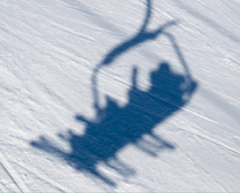
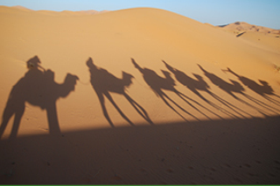
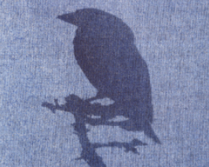
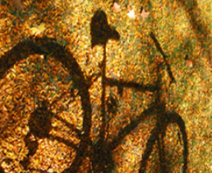


How are shadows formed?
Which objects have made these shadows?

Slide 3
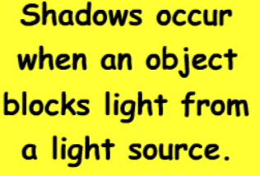
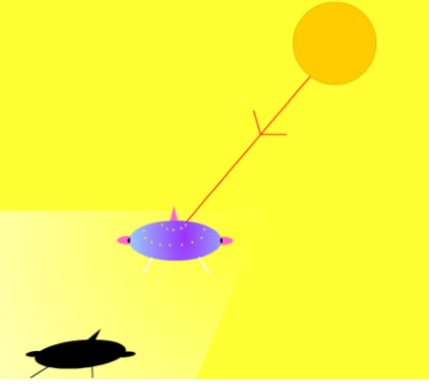

Slide 4

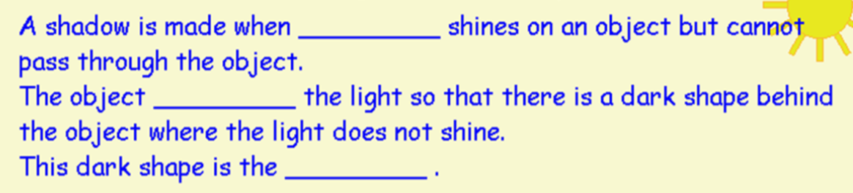



Fill in the missing words to make these sentences correct?

Slide 5
Why do some types of objects make better shadows than others?
Watch the link below to find out more.
During the video look out for 3 important scientific words: transparent, translucent and opaque
https://www.youtube.com/watch?v=YuUJCNzfoBw

Slide 6
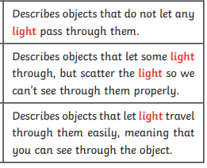
Can you match the words to their meaning?
transparent
opaque
translucent

Slide 7
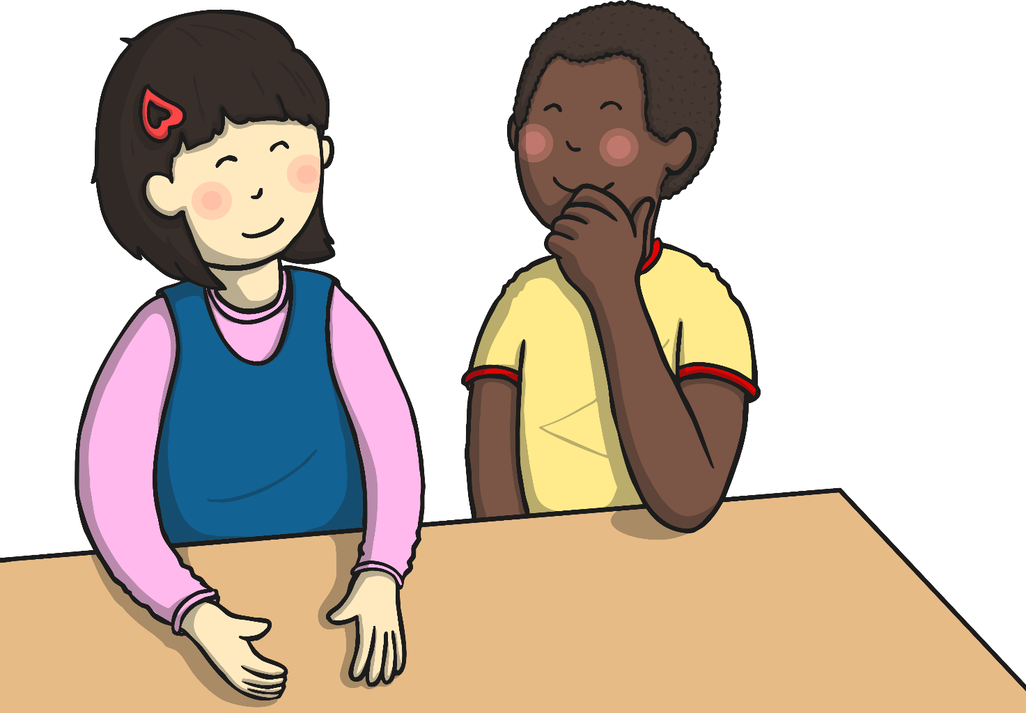

What Do You Think?
Look at these objects and decide if you think they are translucent, transparent or opaque.

Slide 8
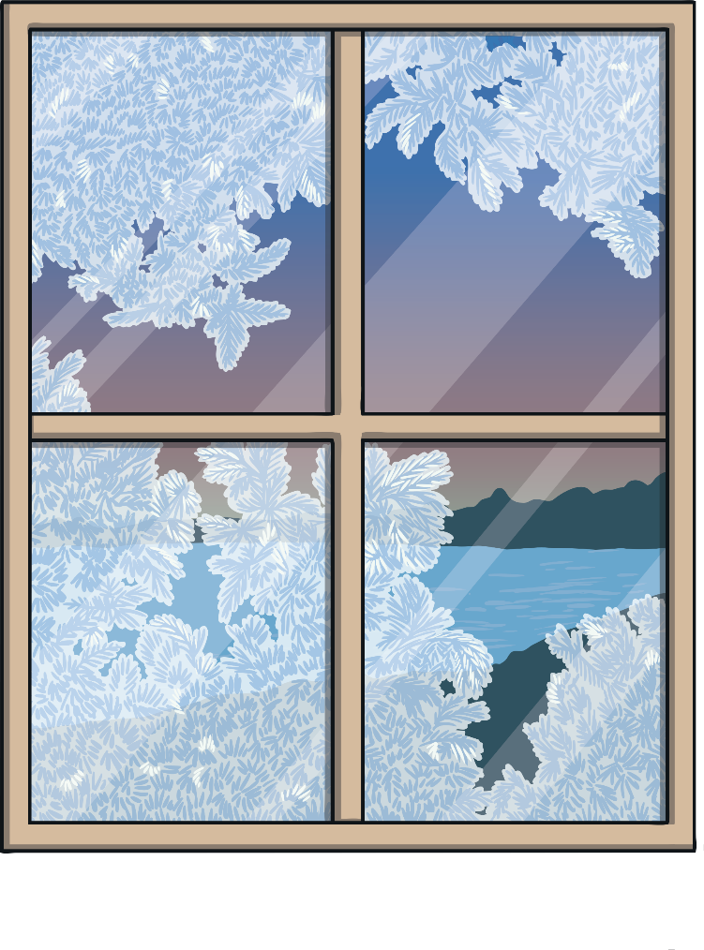
Transparent, Translucent or Opaque?
1. A window
Transparent
Translucent
Opaque

Slide 9

Transparent, Translucent or Opaque?
2. Sunglasses
Transparent
Translucent
Opaque

Slide 10

Transparent, Translucent or Opaque?
3. A book
Transparent
Translucent
Opaque

Slide 11
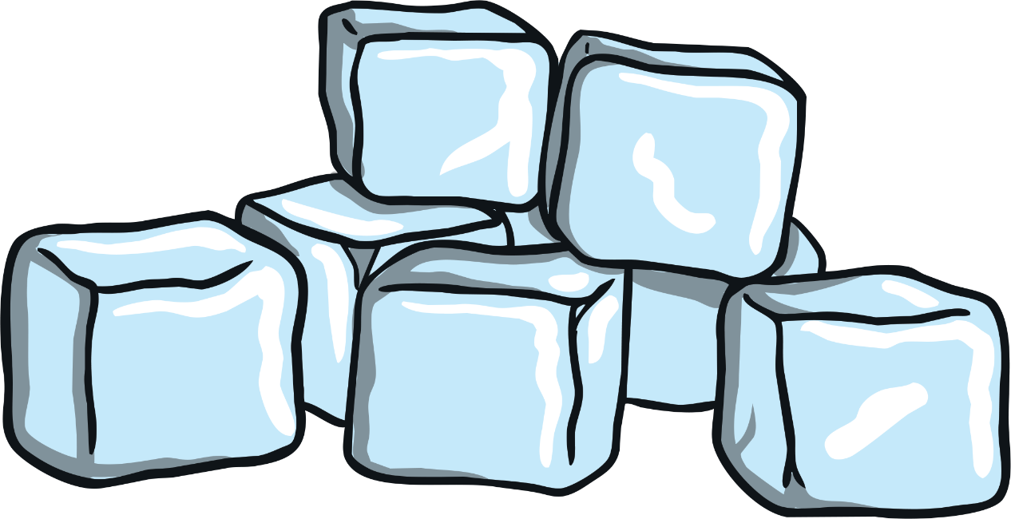
Transparent, Translucent or Opaque?
4. Ice cubes
Transparent
Translucent
Opaque

Slide 12

Transparent, Translucent or Opaque?
5. A glass jar
Transparent
Translucent
Opaque

Slide 13

Transparent, Translucent or Opaque?
6. A coat
Transparent
Translucent
Opaque

Slide 14
Choose an activity to explore further. There are 3 to choose from on the next few slides.
1. Explore your home and make a list of objects using these columns. You can write them down or draw a picture.
Opaque | Translucent | Transparent

Slide 15
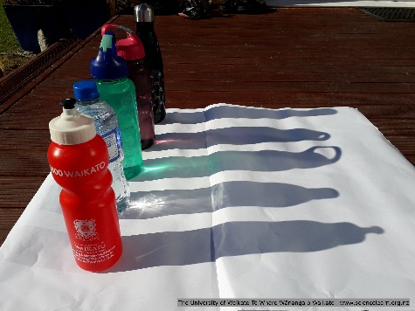
Activities to explore further
2. Gather a selection of objects that are opaque, translucent and transparent. Use a torch for indoor exploration or take the objects outside for observation in strong sunlight.
Observe and discuss what happens when light shines on the objects. You could also take a photo or draw what you see.
Does the light shine through each object?
Do some of the objects let more light shine through than others? How can you tell?
Do some objects block the light from shining through? How can you tell?
Are the shadows the same or different?
Are the shadows dark with definite edges or are they fuzzy?
Do the shadows have colour?

Slide 16
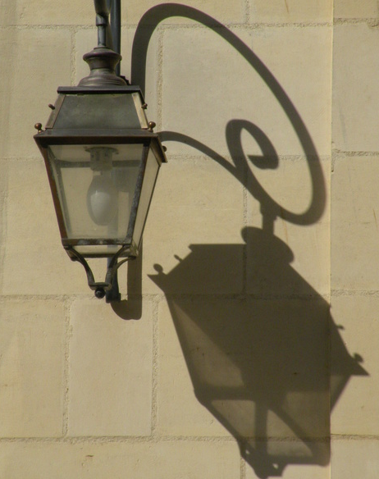
Activities to explore further
3. If you look closely at this image, you can see how the intensity of the lantern’s shadow varies. Explain why some parts of the shadow are darker and more distinct than others.

