Slide 1



Light
Logo for section to sit inside roundel
Exploring reflective surfaces
Key Learning
Some surfaces reflect light.
Objects are easier to see when there is less light if they are reflective.
For the Activities, you will need:
Torch or a phone with a torch function,
A4 piece of white paper/card
5 different materials to test: eg tin foil, black paper, CD or DVD, other paper, wood, metal or fabric.
Use lined paper, ruler and pencil to draw a results table.
Alternatively, print the blank table on your my work folder or the school website.
I can…
identify how objects with different surfaces (e.g. shiny vs matt) are more or less visible.
1

Slide 2
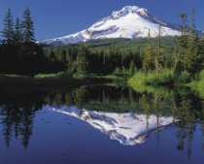
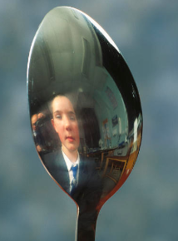
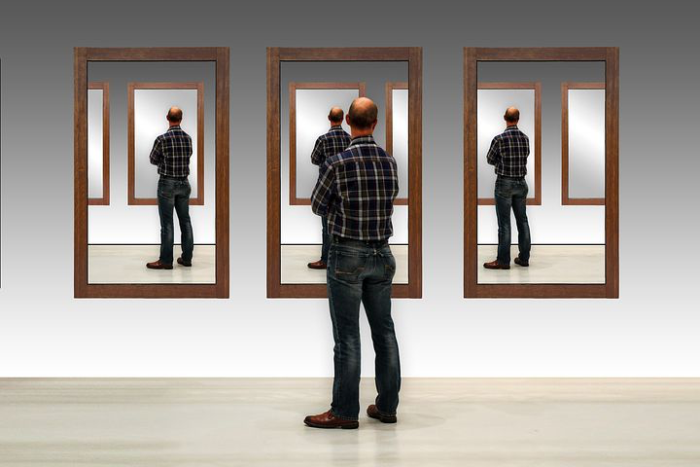
Explore, review, think, talk….
Logo for section to sit inside roundel
What do you already know about reflection?
(5 minutes)
What do we mean by the word ‘reflection’?
Think of as many different reflective surfaces as you can or have an explore around your house.
How many can you name?
2

Slide 3
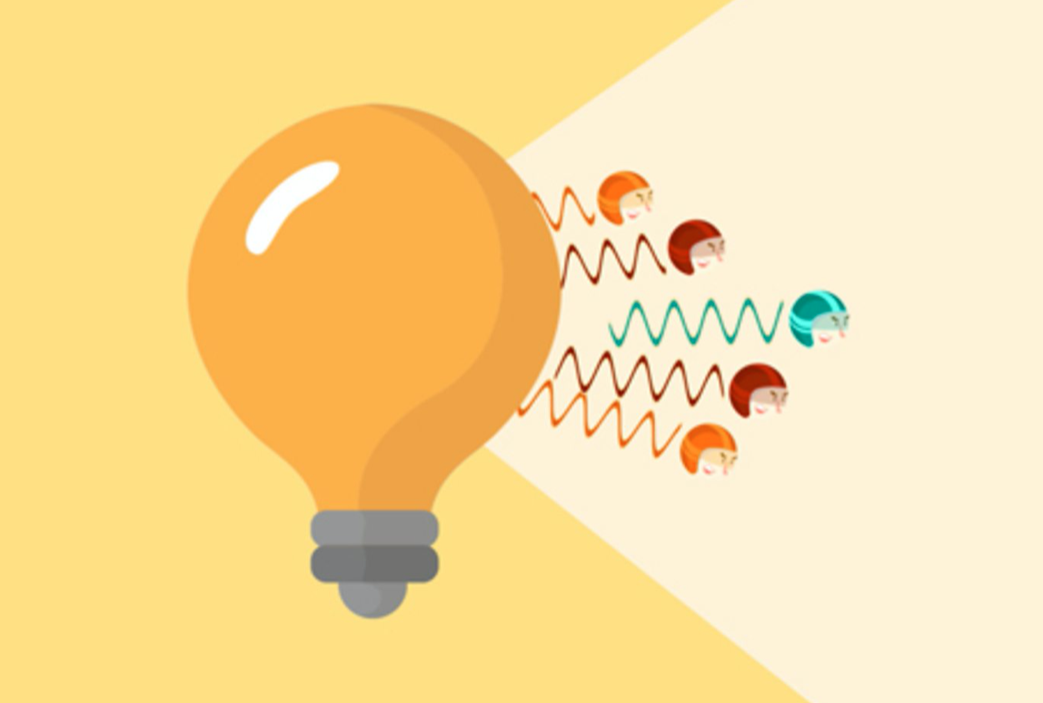
Watch, read, listen…
Logo for section to sit inside roundel
Reflection
(10 minutes)
Watch this clip about reflection.
https://www.bbc.co.uk/bitesize/topics/zbssgk7/articles/zqdxb82
What did you notice about the mirror and the black wall?
When light from an object is reflected by a surface, it changes direction.
It bounces off the surface at the same angle as it hits it.
Smooth, shiny surfaces such as mirrors and polished metals reflect light well.
Dull and dark surfaces such as dark fabrics do not reflect light well.
4

Slide 4
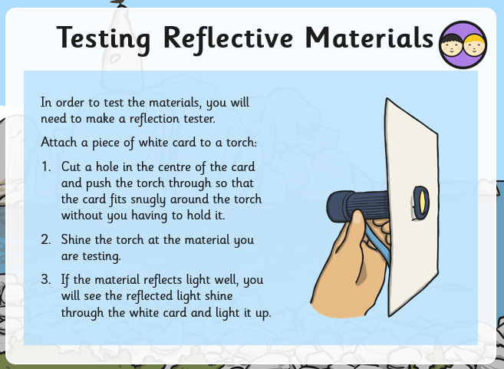
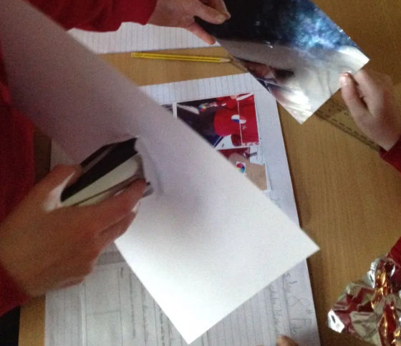
Logo for section to sit inside roundel
Reflection
4

Slide 5
Instructions for Activity
Find a range of different materials and a torch. E.g. tin foil, paper, wood, metal, fabric, laptop, toy.
Use your reflection tester to test how reflective each material is.
Describe each material using adjectives eg dark, smooth, shiny, dull, silver, rough. Photographs/ drawings are a good idea too!
Record your findings in a table. If you are not sure what to write, there is an example of a completed table on slide 7.
Learning outcome: I can identify how objects with different surfaces (e.g. shiny vs dull) are more or less visible.
Object | Describe what it looks like | How shiny is it? (score out of 5)
What do you notice about the objects that reflected the most light?
5

Slide 6
Glossary of terms
bright: If an object is bright it gives out or reflects much light.
dark (scientific): Dark is the absence of light.
dark (everyday): Very little amount of light.
dull: If an object is dull it is not shiny or bright.
light: Light is the form of energy that makes it possible for eyes to see.
material: Anything used for building or making something else.
shiny: Reflecting or glowing with light.
surface: The outside limit or top layer of something.
6

Slide 7
Possible learning outcome for reviewing your work: I can explore the need for light to see things.
Encourage for interesting descriptions and use of adjectives to describe each object. Photographs/ drawings are a good idea too!
Object | Describe what it looks like | How shiny is it? (score out of 5)
Tin foil | Silver, shiny | 4/5 - quite shiny
Table | Hard, smooth, tough, dull | 1/5
C.D. | Shiny, smooth | 5/5 – only on one side. The other side is dull
Black paper | Dark, dull, smooth, flat | 0/5 – nothing is reflected
Laptop | Silver, smooth, dull | 1/5 – only a little bit is reflected
What do you notice about the objects that reflected the most light? An object is very shiny if light reflects very well from it. Some objects are shinier than others because they reflect light well.
Encourage your child to explain their ideas. This will help them understand light & reflection better.
7

