Slide 2
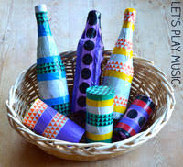
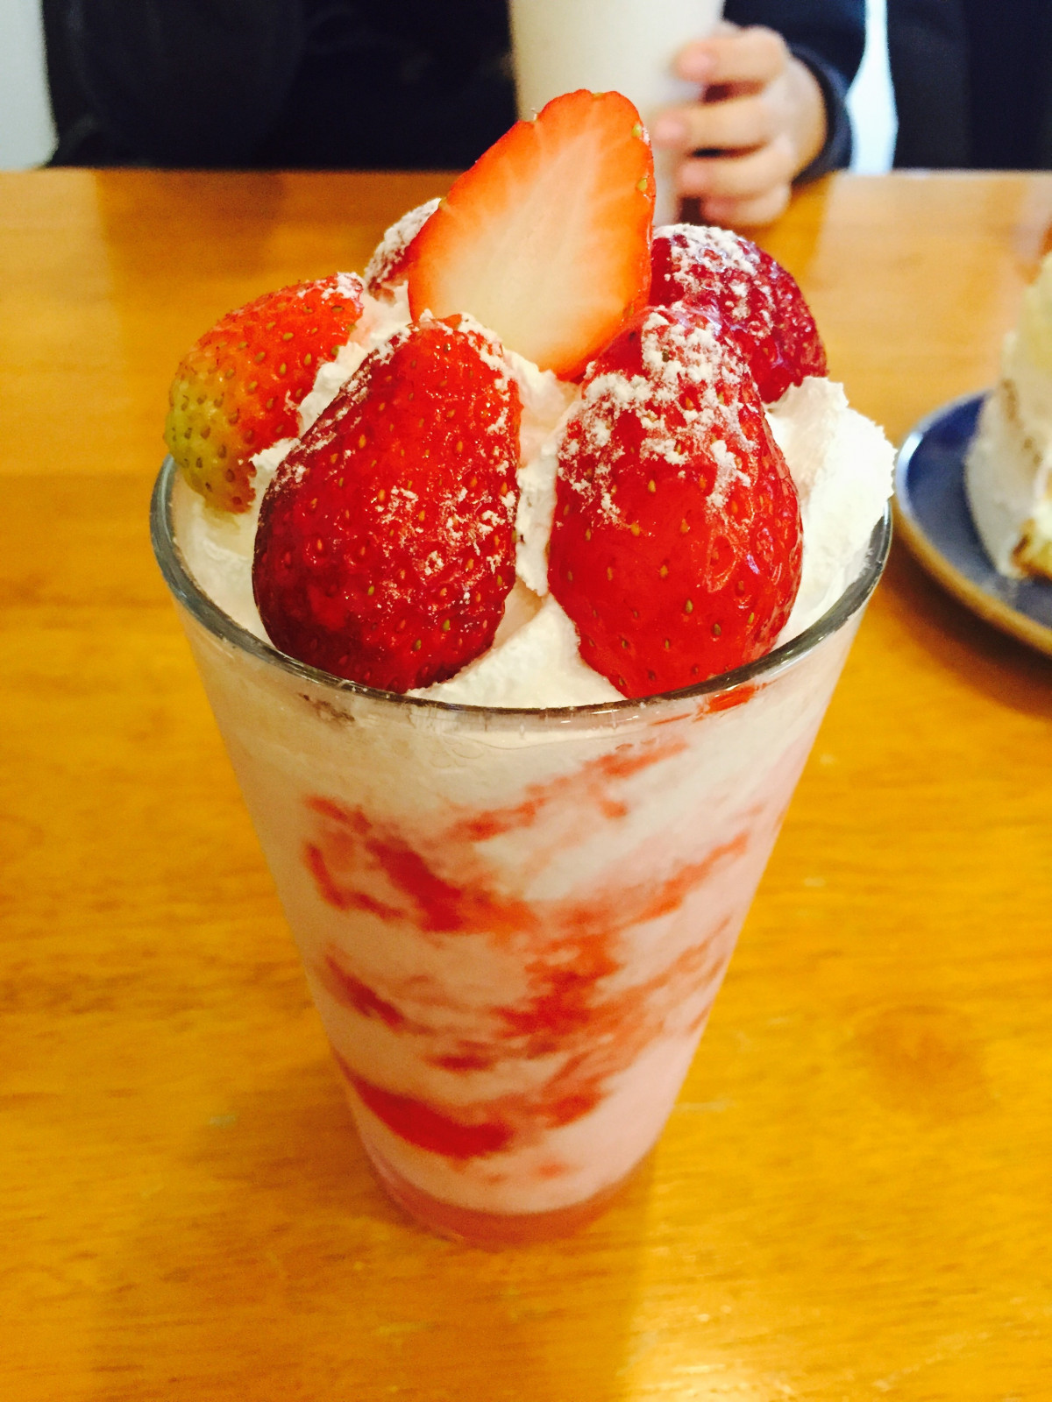
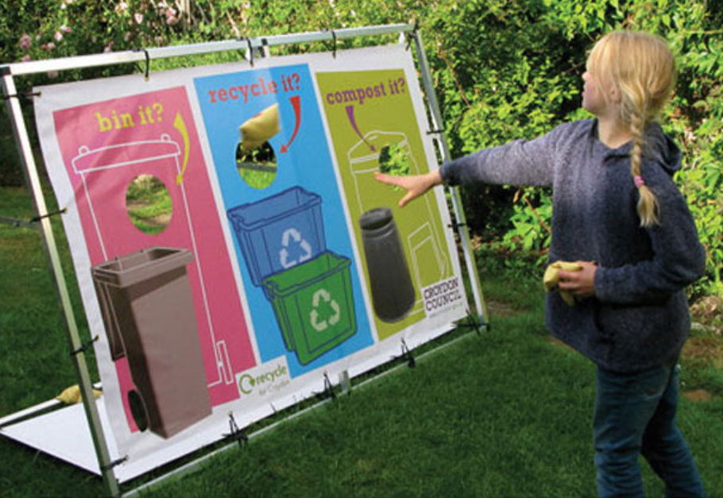


FREE Family SUMMER Holiday Musical Craft Day . Come and Join us at your local library and make a musical shaker from a plastic bottle
Join our professional chef & Prepare a tasty fruit Sundae
Test your Recycling knowledge with our fun bean bag game
Make a plant pot from newspaper
PLUS free Drinks & refreshments
Venues & dates
Wisbech Library 22nd July 2026 , 10:00am- 11:30 am
Cottenham Library 23rd July 2026 , 2pm- 4pm
Bar Hill Library 28th July 2026, 2pm-4pm
Cambridge Central Library 30th July 2026 , 10:00am – 12:00
Cambourne Library 4th August 2026 10am -12;00
Whittlesey Library 11th August 2026 10am – 12
Soham Library 19th August 2026 2pm-4pm
Ely Library 25th August 2026 10am-12 noon
FREE

