Slide 1
Planet Unknown
LO. To write a story setting for a fantasy land.
Think about:
What can you see?
What can you hear?
Describe your setting using powerful vocabulary and create images by using a simile or a metaphor.

Slide 2
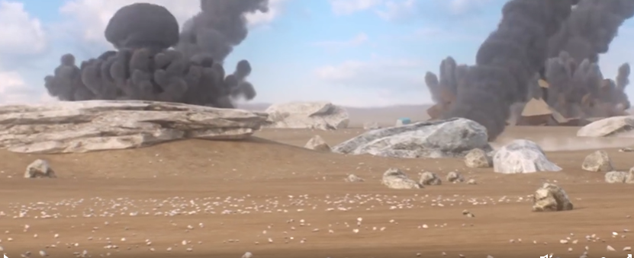
Planet Unknown
At the end of the 21st century Mankind were facing global resource depletion. Space Rovers were sent out to find potential inhabitable planets. nSeed were carried by these Space Rovers to test the possibility of growing plants on a target planet.

Slide 3
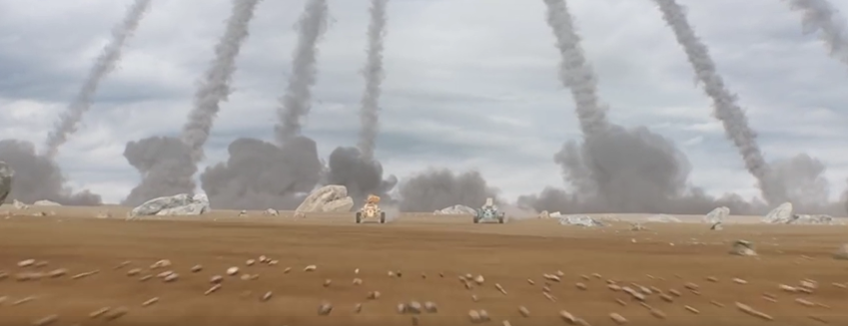

Slide 4
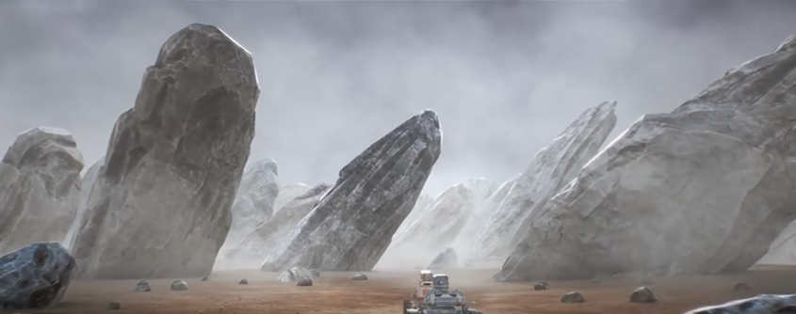

Slide 5
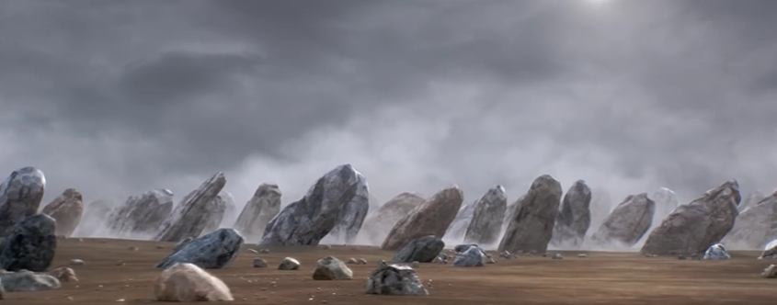

Slide 6
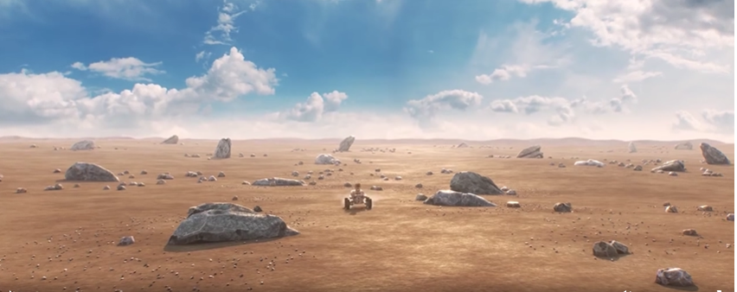

Slide 7
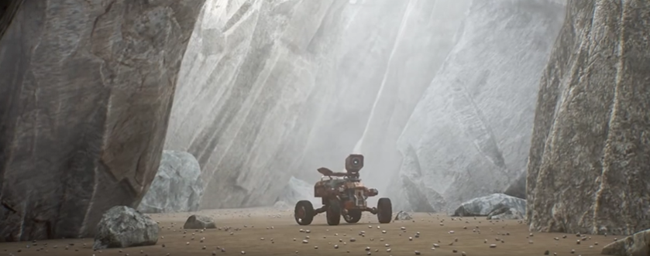

Slide 8
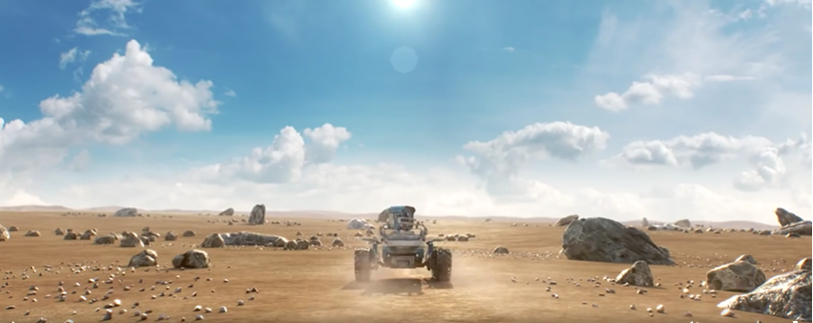

Slide 9
You may want to describe your own planet -
Planet Unknown
You could magpie ideas that you have
read in a favourite book.
You may want to use the same
planet ideas that we discussed today.
There are a few more fantasy lands on the next
few slides that might help you with ideas too.
It’s up to you!

Slide 10
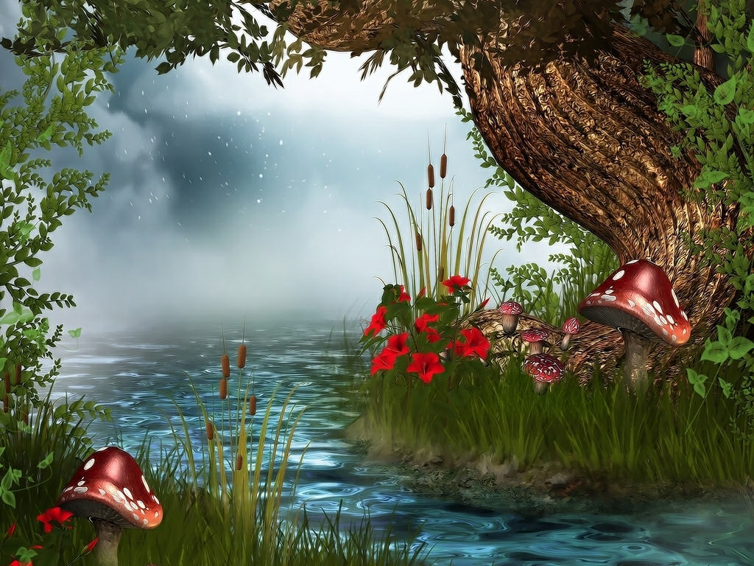

Slide 11
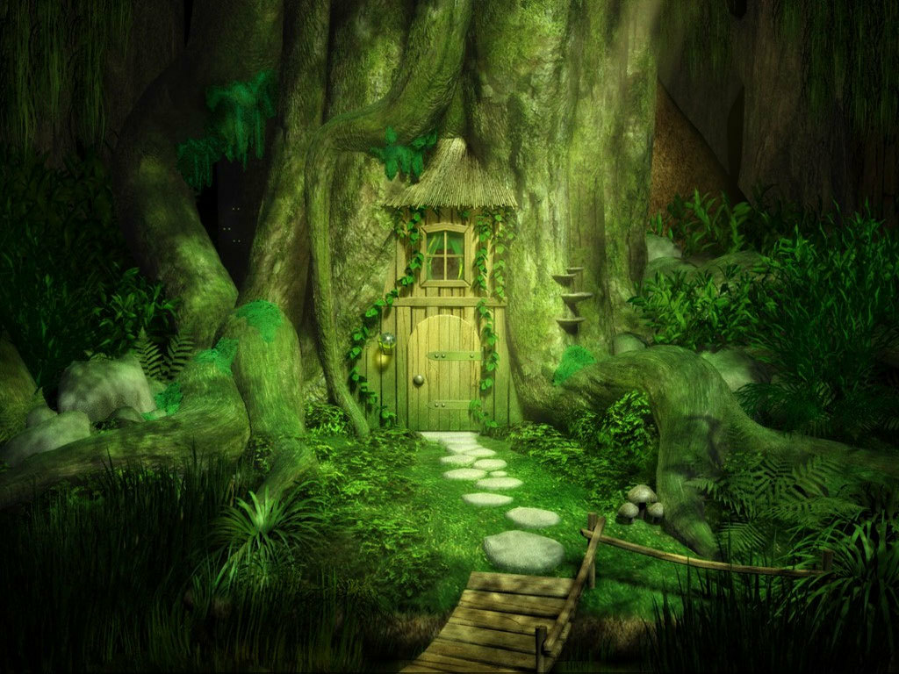

Slide 12
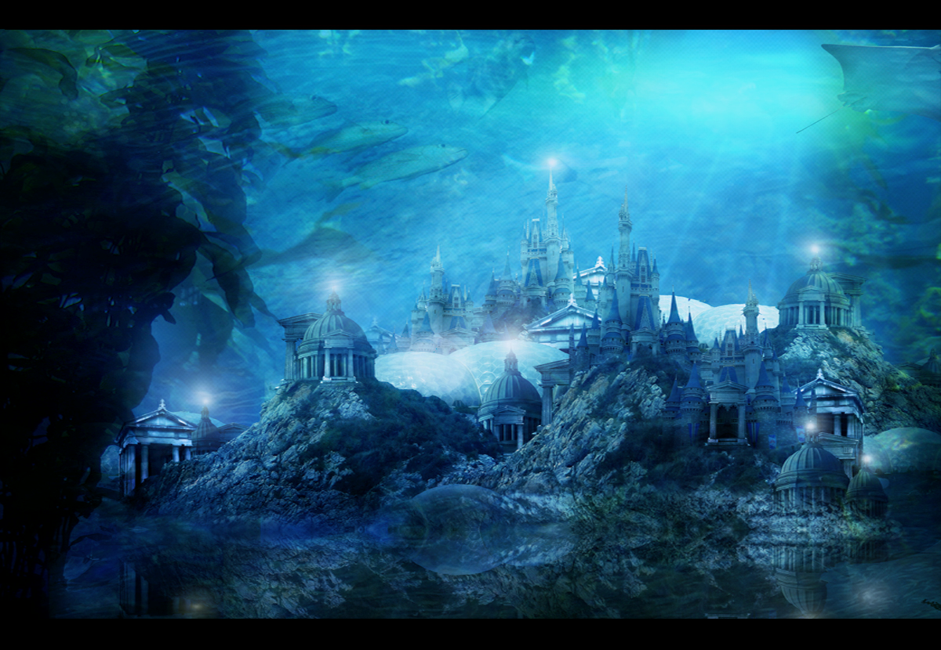

Slide 13


