Slide 1

Strengthening techniques
Subtitle
1

Slide 2

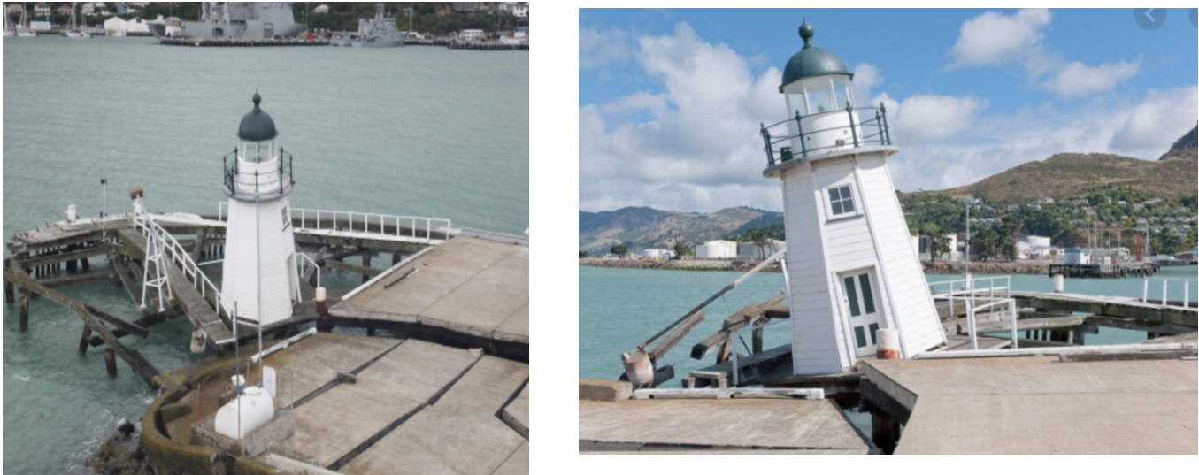
This lighthouse wasn't built on strong ground so now it won't be much useful.
So your first job is to find and create a strong base for your lighthouse to stand on so it can withstand the forces of nature.
2

Slide 3
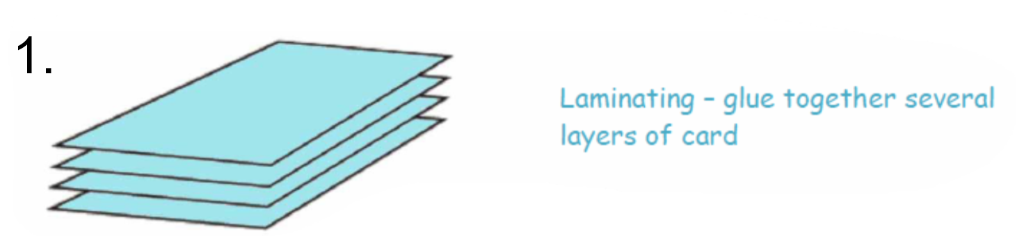
How do you strengthen a structure?
Technique 1: Laminating
3

Slide 4
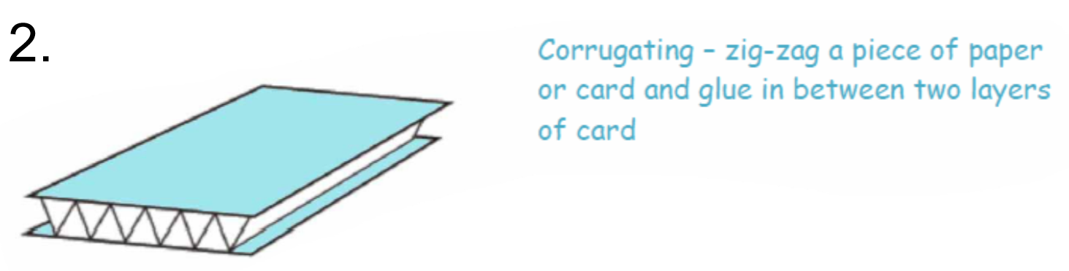
How do you strengthen a structure?
Technique 2: Corrugating
4

Slide 5
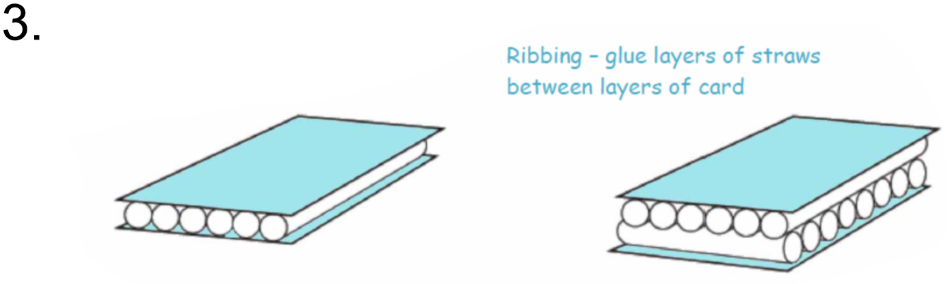
How do you strengthen a structure?
Technique 3: Ribbing
5

Slide 6

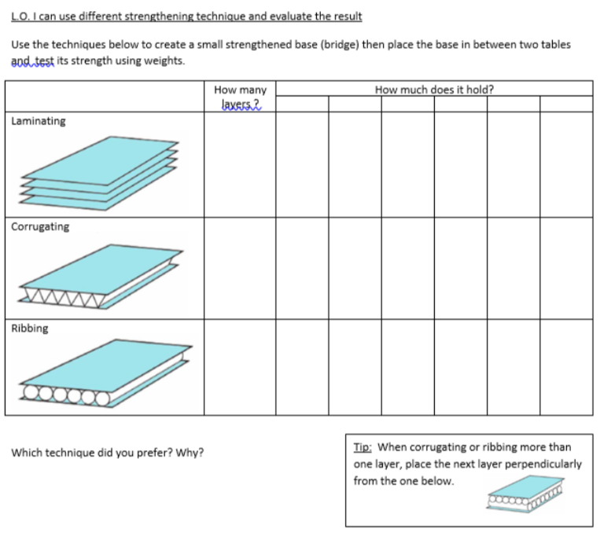

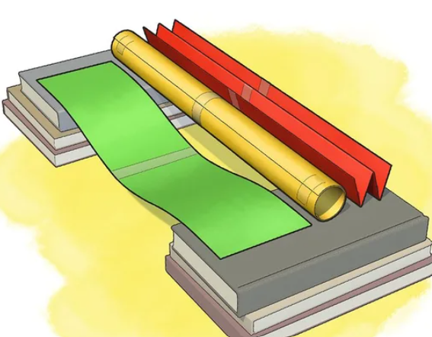
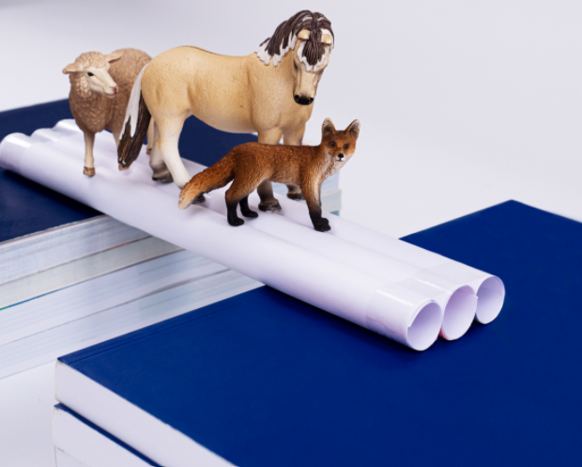

Quote and Image Slide
Let’s test the different techniques…
Record your findings on your test sheet.
Make 3 bridges – each using a different technique.
Put different weights on to test their strength.
by making paper bridges!
6

