Slide 1
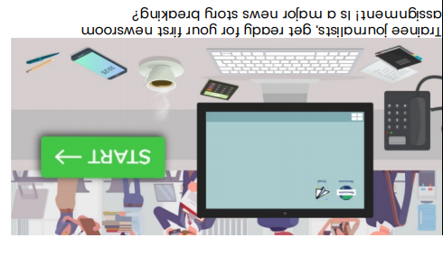
LO. To interpret a variety of communication through technology systems to build up details of an emerging news story.

Slide 2
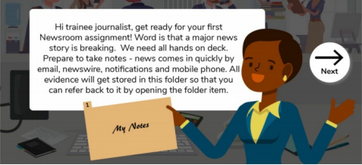
Hi trainee journalist, get ready for your first newsroom assignment. Word is that a major news story is breaking. We need all hands on deck.
Prepare to take notes – news comes in quickly by email, newswire, notifications and mobile phone.

Slide 3
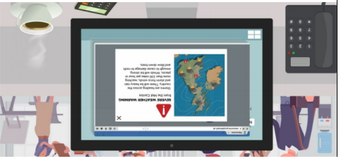
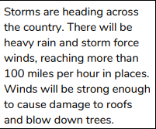
Means of Communication - News Report/ News Wire

Slide 4
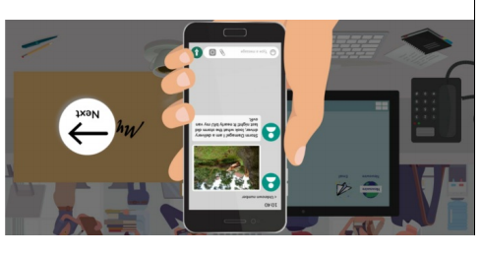

Means of Communication - Incoming Text Message

Slide 5
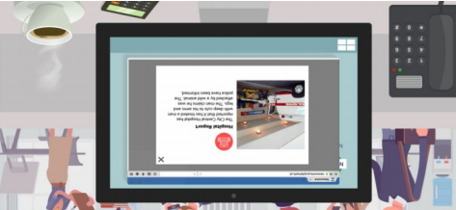

Means of Communication - News Report/ News Wire

Slide 6
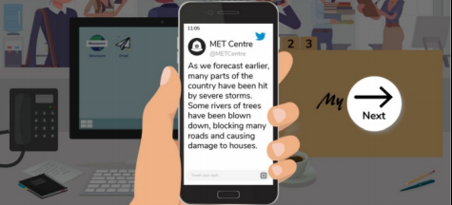
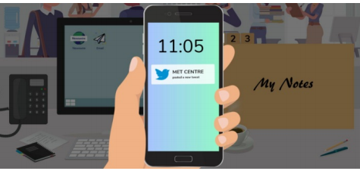

Means of Communication - Incoming Tweet

Slide 7
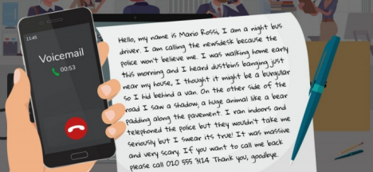
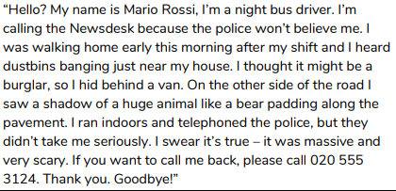
Means of Communication –
Phone Message/Incoming Voicemail

Slide 8
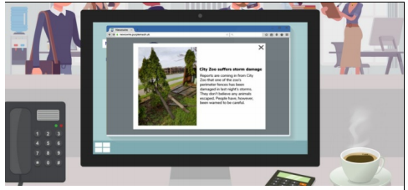

Means of Communication - News Report/ News Wire

Slide 9
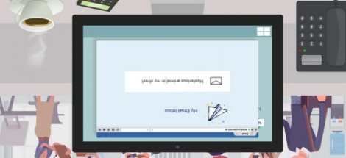
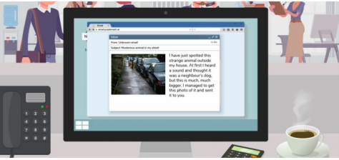
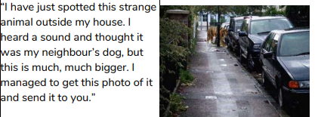
Means of Communication - Incoming Email

Slide 10
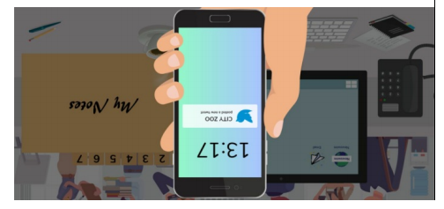
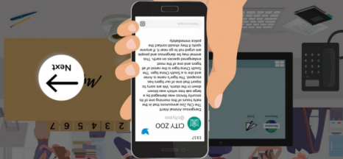
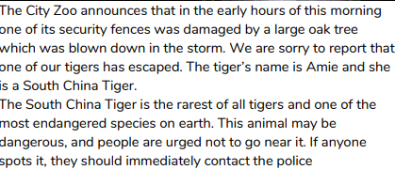
Incoming Tweet
Means of Communication - Incoming Tweet

Slide 11
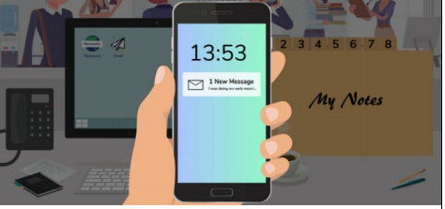
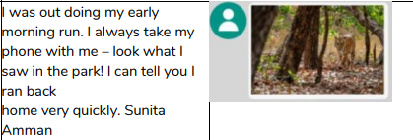
Means of Communication –
Incoming Text Message

Slide 12
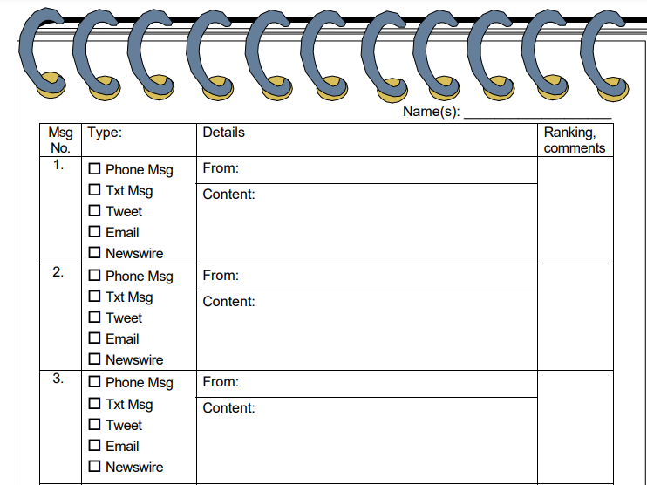

Slide 13


