Slide 1
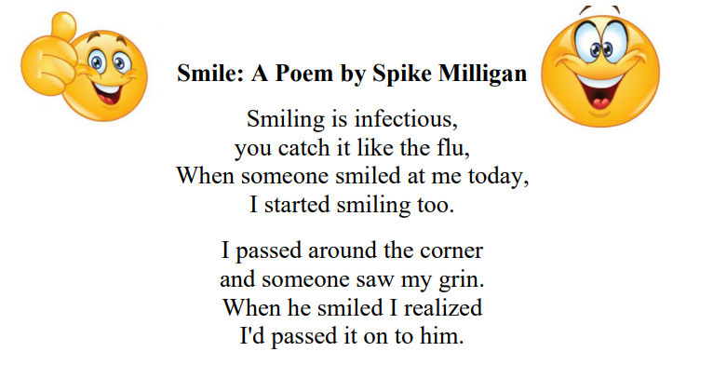

Slide 2
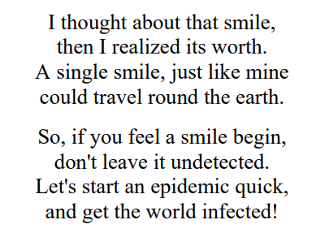

Slide 3
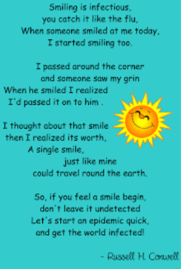

Slide 4

Smiling Is Infectious
Listen to these clips
https://www.youtube.com/watch?v=Hr0Iw3gVM9M
https://www.youtube.com/watch?v=-4fIVD06lRQ
https://www.youtube.com/watch?v=4BcMRVfKwrQ
https://www.youtube.com/watch?v=3K7gbv_CoQ8

Slide 5
Smiling Is Infectious
What does undetected mean?
What does infectious mean?
What do we mean by a pandemic?

Slide 6


Slide 7


Slide 8
When you smile….
What makes you smile?
Is it your favourite food?
Seeing your friends or family?
Going on holiday?

Slide 9
When you smile...
I see waves crashing on the golden sand,
My friends playing together at the park,
People shopping and chatting merrily,
Families being reunited after months of lockdown,
Children running in the playground,
Doctors having a rest from Covid

