Slide 1
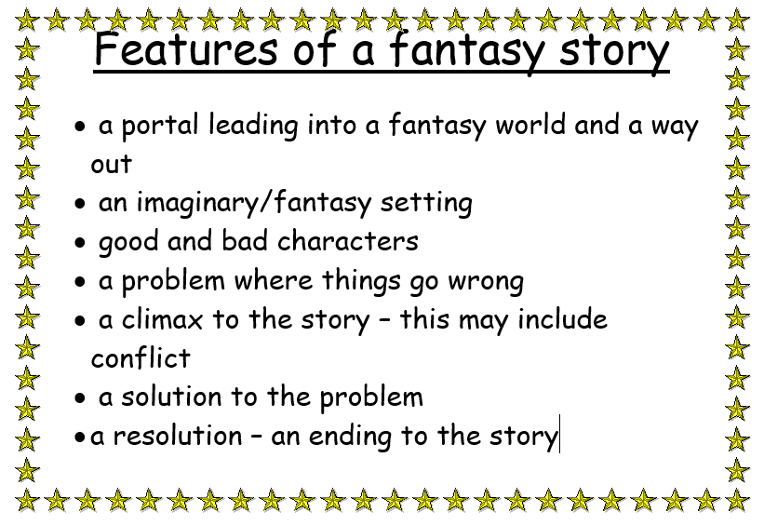
and of course a little bit of magic!

Slide 2
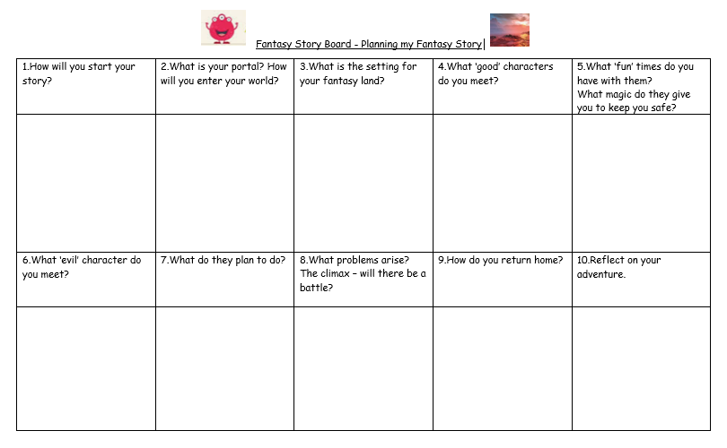

Slide 3
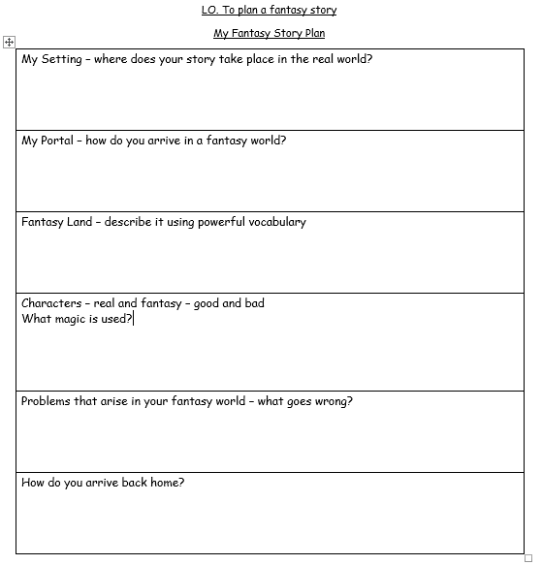

Slide 4

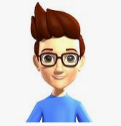
Whatever you do Tom, do not touch the button with the spaceship on it.
You’ve been warned!
Story Starter
I have chosen to start with direct speech and a warning from Dad.

Slide 5
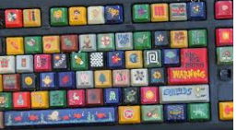

My Portal
My portal is a computer keyboard and a special spaceship button.

Slide 6
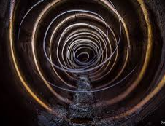

Agghhhhhhhhhhhhh!
Too late!
Help!
Tom is spinning and whizzing through the portal

Slide 7
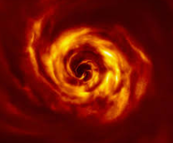
Where am I going?
Twirling through the portal

Slide 8
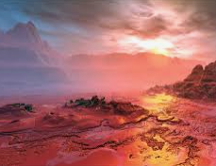
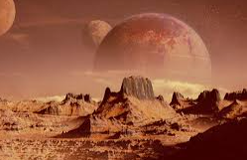
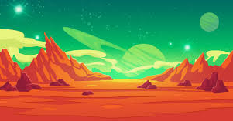
Where am I?
What is this place.
Is it the unknown planet?
The setting – an unknown planet!

Slide 9
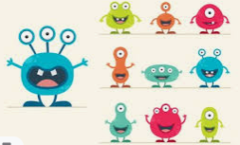
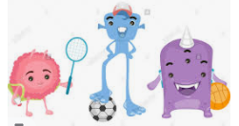
Hey there Tom!
We’re the cuties!
Come and play with us!
Watch out for the beastly alien though.
Introducing the characters
I have chosen the cuties as my good characters.

Slide 10
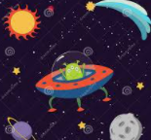
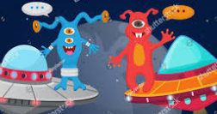
This is fun!
What shall we play?
Settling into the new planet
Good time before bad …….

Slide 11
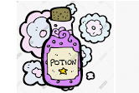


Here … take this magic potion.
Keep it safe.
It makes people invisible.
Only take it when you are in real trouble.

Slide 12
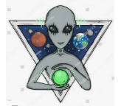
Introducing the evil character.
He wants to turn Tom into stone!
Not so fast you cuties!
I am going to turn any human that dares to walk on my planet into stone.
My aliens will catch you – don’t hang around!
Ha ha ha!

Slide 13
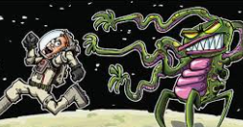
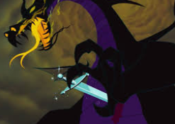
The Problem!
Tom is being chased by an alien
Problem 2 – Building into the climax
Another alien … this one’s got a sword and breathes fire!

Slide 14

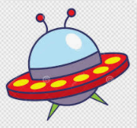
Solving the problem
Trying to get home!
Quick Tom!
Get in the space ship.
Find the keyboard.
Press the spaceship button.

Slide 15



The Resolution
But was it all a dream?

