Slide 1
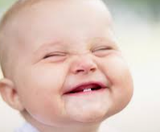

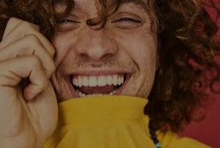
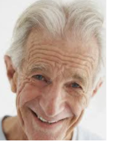
Smiling Is The Best Medicine!
In the Store Full of Magical Things, the young girl wanted to buy a smile that would never fade.
Why did she choose this?
I have been thinking about it and want to share what I have found out.
I hope you will be smiling by the end of it!

Slide 2

Smiling Is Infectious
https://www.youtube.com/watch?v=-4fIVD06lRQ
(lady)
https://www.youtube.com/watch?v=Hr0Iw3gVM9M
(man with guitar)
https://www.youtube.com/watch?v=nfqV_oOJ4HY
(girl)
Listen to these clips

Slide 3
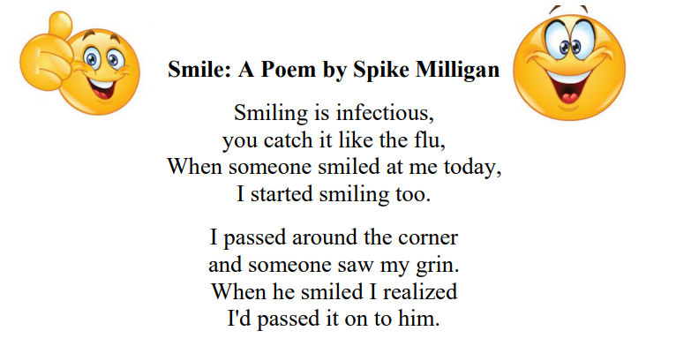

Slide 4
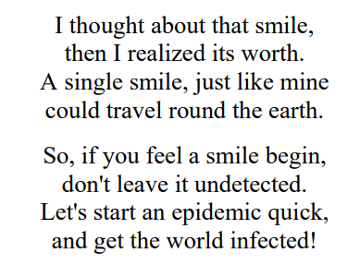

Slide 5
Smiling Is Infectious
What does undetected mean?
What does infectious mean?
What do we mean by a pandemic?

Slide 6
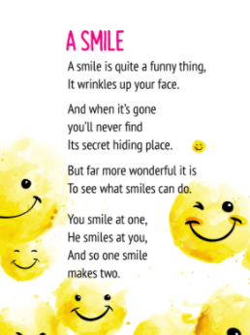

Slide 7


Slide 8
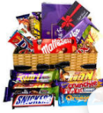
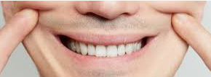
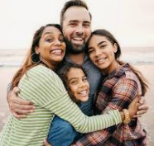

When you smile….
What makes you smile?
Is it your favourite food?
Seeing your friends or family?
Going on holiday?

Slide 9
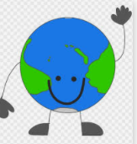
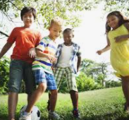
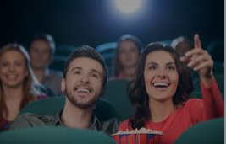
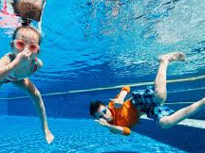

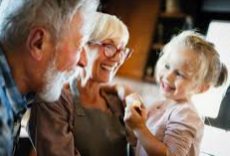
When you smile...
I see waves crashing on the golden sand,
My friends playing together at the park,
The big screen at the cinema,
Us having fun in the swimming pool,
Families being reunited after months of lockdown,
Children running in the playground,
The world smiling with you.

Slide 10
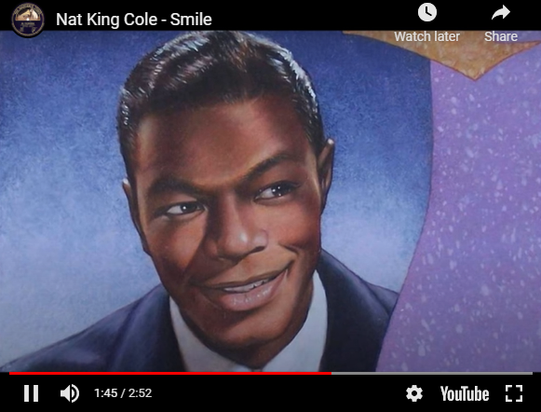
“You’ll get by, if you smile through your fear and sorrow,
Smile, and maybe tomorrow, you’ll see the sun come shining through”
https://www.nme.com/blogs/nme-blogs/listomania-10-songs-about-smiling-9598

Slide 11


