Slide 2

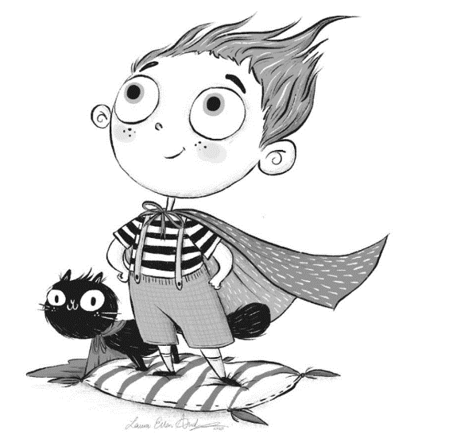



There’s a Hero Inside All of Us
Look at this great illustration by Laura Ellen Anderson.
Click on each member of the Totally Pawsome Gang and help them to read the picture.
Inference Iggy
Predicting Pip
Sequencing Suki
Inference Iggy wants to know…
How do you think the child feels?
What makes you think that?
Back to Menu
Answers
There’s a Hero Inside All of Us
Copyright © Laura Ellen Anderson 2020

Slide 3


There’s a Hero Inside All of Us
Look at this great illustration by Laura Ellen Anderson.
Click on each member of the Totally Pawsome Gang and help them to read the picture.
Inference Iggy
Predicting Pip
Sequencing Suki
Predicting Pip wants to know…
What might the child do next?
Back to Menu
Answers
There’s a Hero Inside All of Us
Copyright © Laura Ellen Anderson 2020

Slide 4

There’s a Hero Inside All of Us
Look at this great illustration by Laura Ellen Anderson.
Click on each member of the Totally Pawsome Gang and help them to read the picture.
Inference Iggy
Predicting Pip
Sequencing Suki
Sequencing Suki wants to know…
How could you use 20 words or fewer to sum up what is happening in this picture?
Back to Menu
Answers
There’s a Hero Inside All of Us
Copyright © Laura Ellen Anderson 2020

Slide 5



There’s a Hero Inside All of Us Answers
Click on each card to reveal an example answer.
Inference Iggy
Predicting Pip
Sequencing Suki
How do you think
the child feels?
What makes you think that?
What might the
child do next?
How could you use
20 words or fewer to sum up what is happening in this picture?
I think that the child might plan an adventure that they can go on with their cat.
I think that the child feels proud of themselves because they are smiling and they look confident.
Reveal Answer
I can see a child dressed as a superhero who is standing on a pillow next to their cat.
Reveal Answer
Reveal Answer
Back to Menu
There’s a Hero Inside All of Us
Copyright © Laura Ellen Anderson 2020

Slide 6
There’s a Hero Inside All of Us
Back to Menu
Zoom Out
There’s a Hero Inside All of Us
Copyright © Laura Ellen Anderson 2020

