Slide 1


Year 4 – Summer Block 5 – Properties of Shape
Lo: To identify lines of symmetry in 2D shapes
© Classroom Secrets Limited 2018

Slide 2
Introduction
Watch:
https://www.bbc.co.uk/bitesize/topics/zrhp34j/articles/z8t72p3

Slide 3
Introduction
Which of the following shapes have more than one line of symmetry?
© Classroom Secrets Limited 2018

Slide 4
Introduction
Which of the following shapes have more than one line of symmetry?
© Classroom Secrets Limited 2018

Slide 5
Varied Fluency 1
Which shape has the correct lines of symmetry marked?
A
B
C
© Classroom Secrets Limited 2018

Slide 6
Varied Fluency 1
Which shape has the correct lines of symmetry marked?
Shape A
A
B
C
© Classroom Secrets Limited 2018

Slide 7



Varied Fluency 2
Match the halves which go together to make symmetrical shapes.
B
C
A
D
F
E
© Classroom Secrets Limited 2018

Slide 8
Varied Fluency 2
Match the halves which go together to make symmetrical shapes.
A and C; B and D; E and F
B
C
A
D
F
E
© Classroom Secrets Limited 2018

Slide 9



Varied Fluency 3
Pair the lines of symmetry with the shapes they match.
A
B
C
E
D
F
© Classroom Secrets Limited 2018

Slide 10
Varied Fluency 3
Pair the lines of symmetry with the shapes they match.
A and B; C and F; D and E
A
B
C
E
D
F
© Classroom Secrets Limited 2018

Slide 11
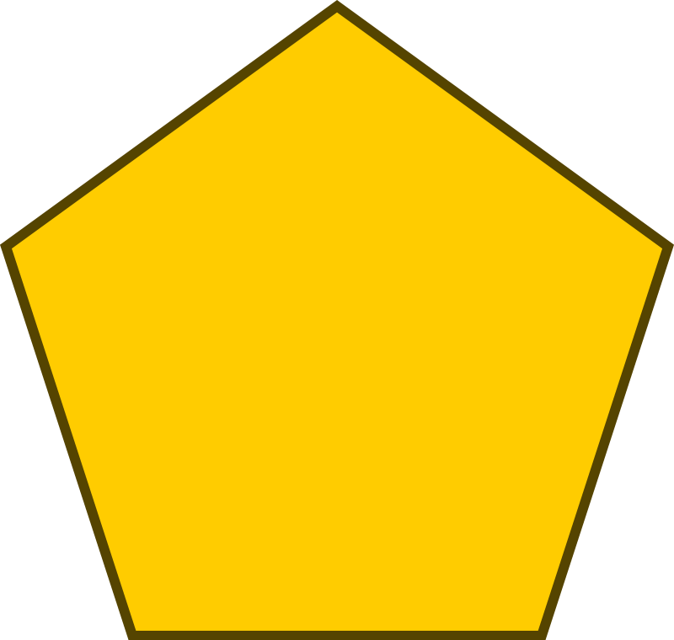


Reasoning 1
Eustace has filled in this Venn diagram with shapes.
Find and explain his mistake.
Vertical line of symmetry
Horizontal line of symmetry
© Classroom Secrets Limited 2018

Slide 12
Reasoning 1
Eustace has filled in this Venn diagram with shapes.
Find and explain his mistake.
Eustace has put the pentagon in the ‘Vertical line of symmetry’ section when in that orientation. It should be in the ‘Horizontal line of symmetry’ section instead.
Vertical line of symmetry
Horizontal line of symmetry
© Classroom Secrets Limited 2018

Slide 13
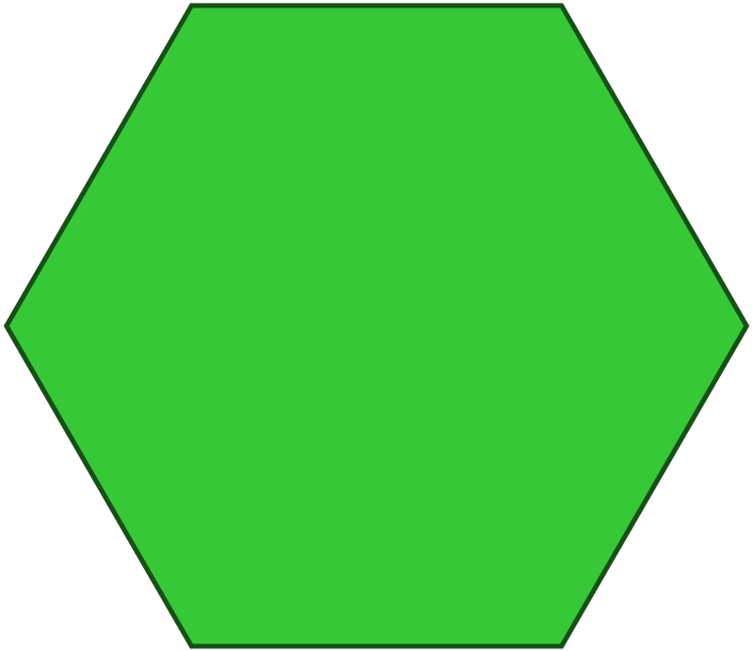
Problem Solving 1
Here is an image made up of several shapes.
How many lines of symmetry does the image (not the individual shapes) have?
© Classroom Secrets Limited 2018

Slide 14
Problem Solving 1
Here is an image made up of several shapes.
How many lines of symmetry does the image (not the individual shapes) have?
The image has 1 line of symmetry.
© Classroom Secrets Limited 2018

Slide 15
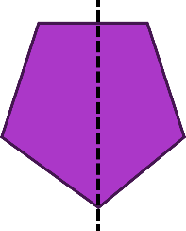
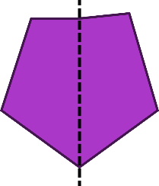
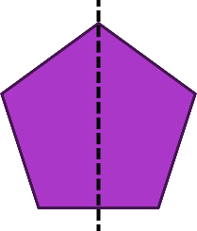
Reasoning 2
Here are 3 attempts at drawing reflections.
Find the reflections that are not symmetrical. Explain why.
A
B
C
© Classroom Secrets Limited 2018

Slide 16
Reasoning 2
Here are 3 attempts at drawing reflections.
Find the reflections that are not symmetrical. Explain why.
Shapes A and B are not symmetrical. The right-hand part of shape A is narrower than the left-hand side. The top-right-hand corner of reflection B is higher and further out than the top-left-hand corner.
A
B
C
© Classroom Secrets Limited 2018

