Slide 1
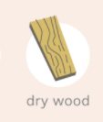
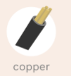




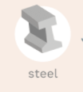
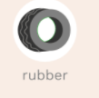


LO: To recognise some common conductors and insulators, and associate metals with being good conductors.
What is a conductor?
What is an insulator?
How can we find out which materials are good conductors of electricity and which are insulators?

Slide 2
Video links to watch to help you with this lesson:
The Oaks Academy Video:
Stop watching this video at 18:23
2. Watch the BBC Bitesize programme:
https://www.bbc.co.uk/bitesize/topics/z2882hv/articles/zxv482p
https://classroom.thenational.academy/lessons/what-are-insulators-and-conductors-6rtp8t?step=2&activity=video

Slide 3
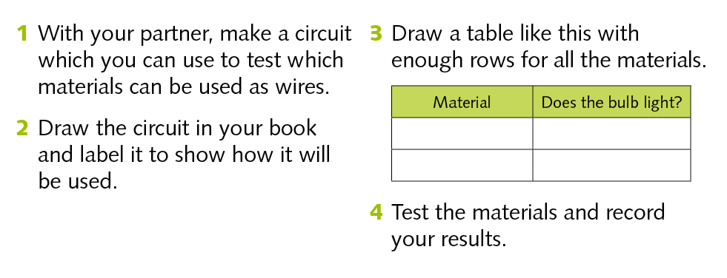
LO: To recognise some common conductors and insulators, and associate metals with being good conductors (for those in school )
Note: If you are working from home, watch the Oaks video and this will help you find out which materials are conductors of electricity.
Try to fill in the chart using the knowledge that you have found out from the video.

Slide 4
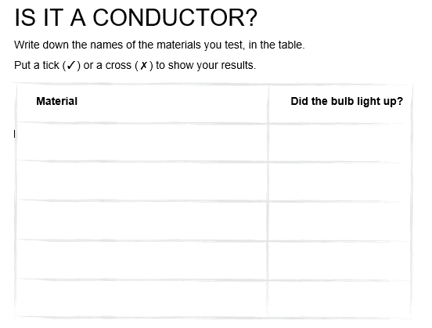
LO: To recognise some common conductors and insulators, and associate metals with being good conductors (for those in school )
Note: If you are working from home, watch the Oaks video and this will help you find out which materials are conductors of electricity.
Try to fill in the chart using the knowledge that you have found out from the video.

Slide 5
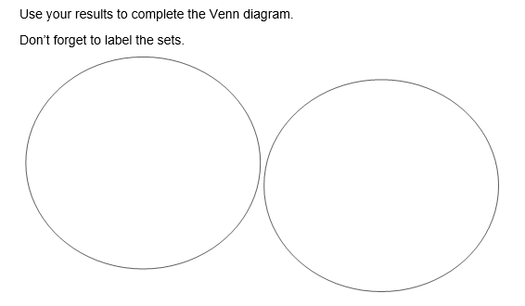
LO: To recognise some common conductors and insulators, and associate metals with being good conductors.
Try to fill in the Venn diagram using the knowledge that you have found out from the video.
Conductors and Insulators ( there is no middle section crossover)

Slide 6
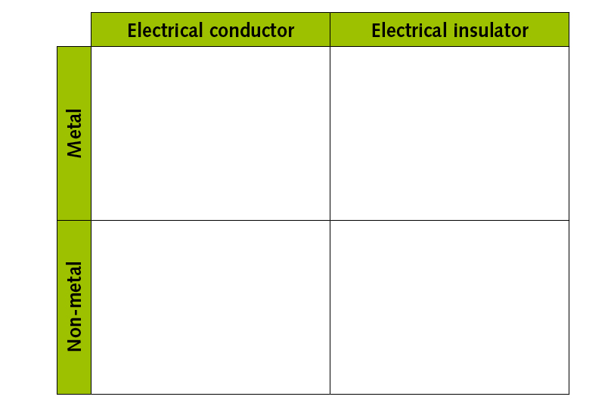
LO: To recognise some common conductors and insulators, and associate metals with being good conductors.
Use your knowledge from what you have learnt today, to complete the Carroll diagram below. Work across a row at a time, reading the statements above. Make sure that you put the correct material in the right box – check the label in the row on the left and the column above.

