Slide 1
Features of a play script
What is a play script? A written version of a play used by actors to prepare and rehearse for a performance.

Slide 2





Title
The name given to the play script.
Annie
Wicked
Macbeth
EastEnders
Romeo and Juliet

Slide 3
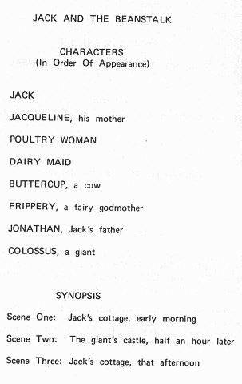
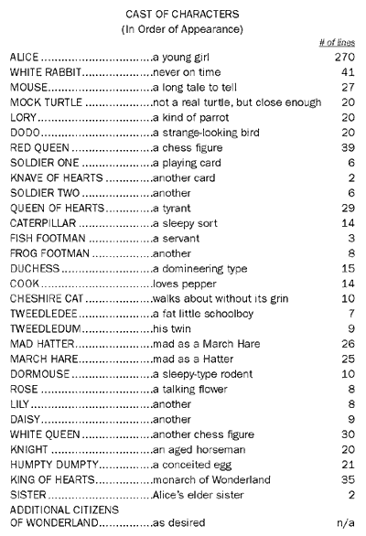
Character List
Found at the beginning of a play script.
It tells us what characters are in the play.
Sometimes it gives us a description of the character and their characteristics.

Slide 4
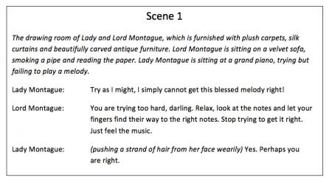
Scenes
Like chapters in a book, it is a different part of the play.
Used when you want to change the location or the time the dialogue is taking place.
At the start of a new scene, it is important to say where and when it is happening.

Slide 5
Setting the scene
Gives the actors information/a description about the scene.
Where it is.
What it is like (weather).
Who is there.
It is a dark, cold night and Mel and Sid are sitting on a green park bench. The street-lights are dim and the sound of the traffic can just be heard in the background.
SCENE ONE: Daddy bear comes into the house. Mummy and baby follow him. They are tired after their morning walk in the woods.

Slide 6
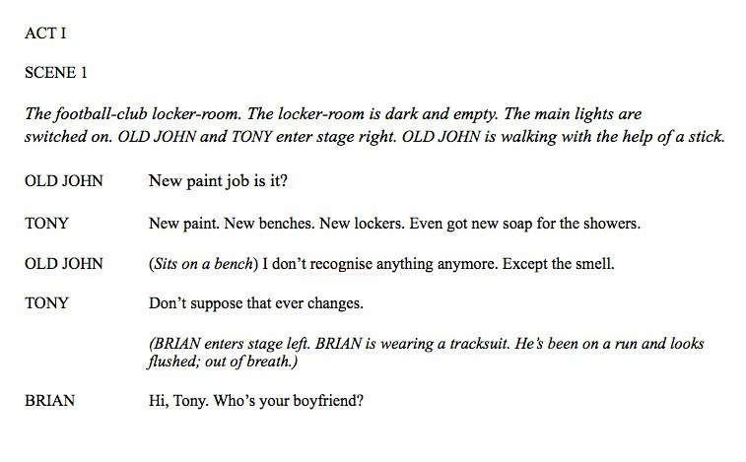
Stage directions
Used to set the scene.
They are an instruction. They tell an actor what they should be doing in that scene (their actions) or how they should talk.
Normally presented in brackets or in italics.

Slide 7
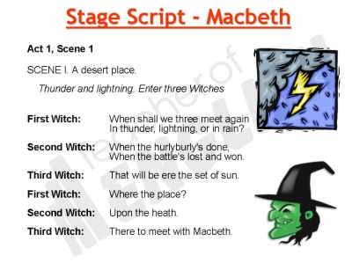
Dialogue
The speech between characters.
The character’s names are on the left-hand side of the page.
No speech marks.
The speech is separated by a colon (:)

Slide 8
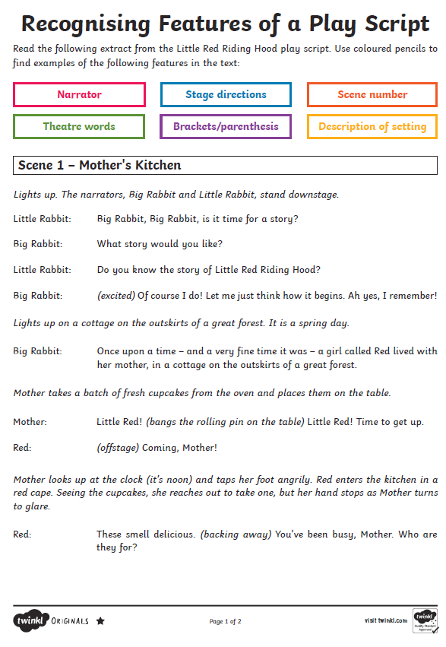
Features of a play script
Now complete the worksheet.
Y3 – 1 star
Y4 – 3 star

