Slide 1




LO. To write stage directions
Can you think of any plays or productions that might need a play script?

Slide 2


Slide 3
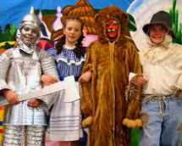

Slide 4
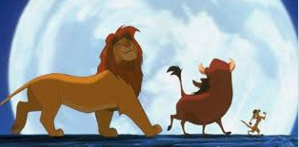

Slide 5


Slide 6


Slide 7



What is the purpose of a stage direction?
Why are they needed?
They give the actors directions of how to act and where to enter the stage. Essentially, everything other than the words they say.
A big part of acting in character is body language and good stage directions are crucial for this.

Slide 8
LO. To write stage directions
Lets’ see why they are so important.
To do this, we need to do some acting. We need to put ourselves in the position of a character.
This is called role play.
Act out these 3 levels of stage directions and explain why the last one is best.
1. (Okay writing) Mother threw her hands up
2. (Better writing) Mother threw her hands up angrily
3. (Best writing) With a vicious scowl on his face, Mother threw her hands up
Remember to use brackets if the direction comes within speech.

Slide 9


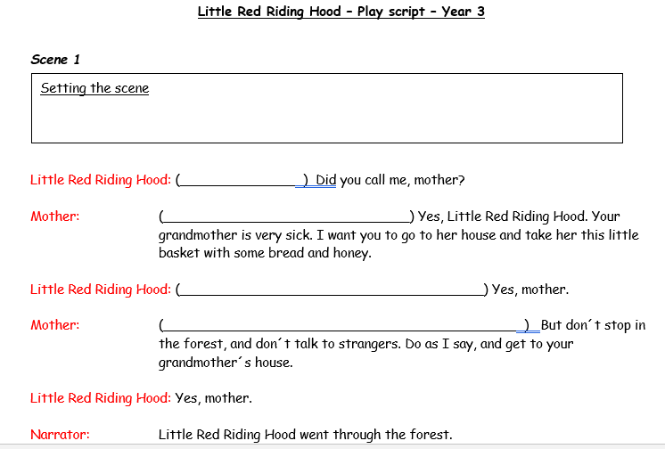
Now complete the sheet Adding stage directions for your year group

