Slide 1


LO. To act out parts of the story, thinking carefully about actions, facial expressions and dialogue.

Slide 2
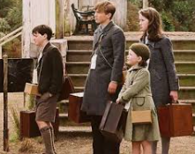
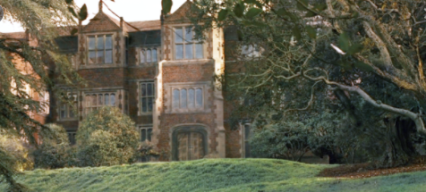
I’m missing home already.
This isn’t a bit like London.
It’s peaceful and quiet and I can
hear the birds tweeting.
Wow! That’s the biggest house
that I’ve ever seen.
I can’t wait to explore.
Look – there’s even great trees to climb.

Slide 3
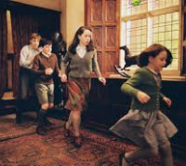
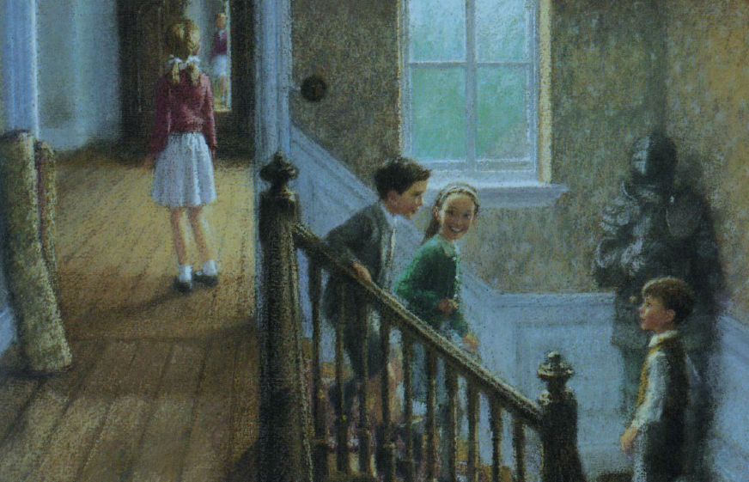
This house is huge!
Let’s explore it now.
There’s so many staircases.
What’s at the end of the corridor?
I need to take a look.

Slide 4
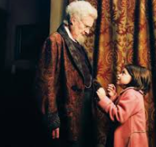
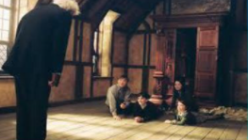
Well hello! You’re not quite what
I expected!
I’m not sure if you’re friendly or not. I’m a bit scared.

Slide 5
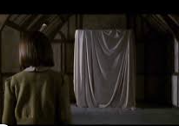
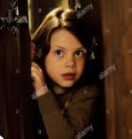
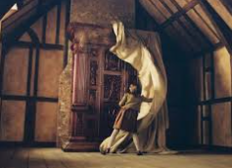
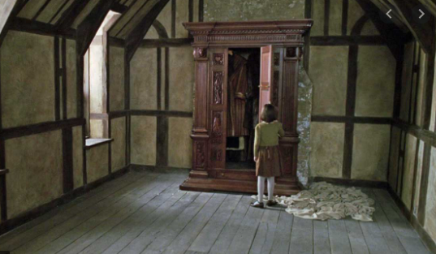
Surely, a quick peek won’t hurt!
Why would you cover up a
wardrobe?
I need to see what’s
inside it.

