Slide 2
Aim
To learn about what sculpture is.
To learn about the materials used to create a sculpture.
To learn how to sculpt with modroc

Slide 3
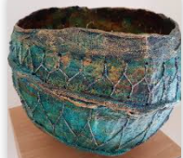
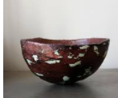
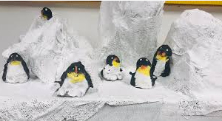
Mod Roc/ Paper mâché
You can paint and decorate your bowl too. Add PVA glue to your paint to make it a thicker consistency which will allow it to coat your bowl properly.
Painted penguins

Slide 4

Mod Roc/ Paper mâché
Take a photo of your final sculpture.

Slide 5


Mod Roc/ Paper mâché
Create a Success Criteria – neat, even
application, stands up firmly, good
patterning, strong and sturdy, fit for
purpose?
Will it do the job you had intended?
If not, why not?
How could you improve it next time?
What did you learn?

