Slide 1


Learning Objectives:
Year 3: Right Angles in Shapes
Year 4: Identify Angles
© Classroom Secrets Limited 2019

Slide 2
Introduction
Look around your classroom/home.
Name some objects that have a right angle in them.
Y3
© Classroom Secrets Limited 2019

Slide 3
Introduction
Sort the angles.
Smaller than a right angle (acute) | Right angle | Larger than a right angle (obtuse)
Y4
© Classroom Secrets Limited 2018

Slide 4
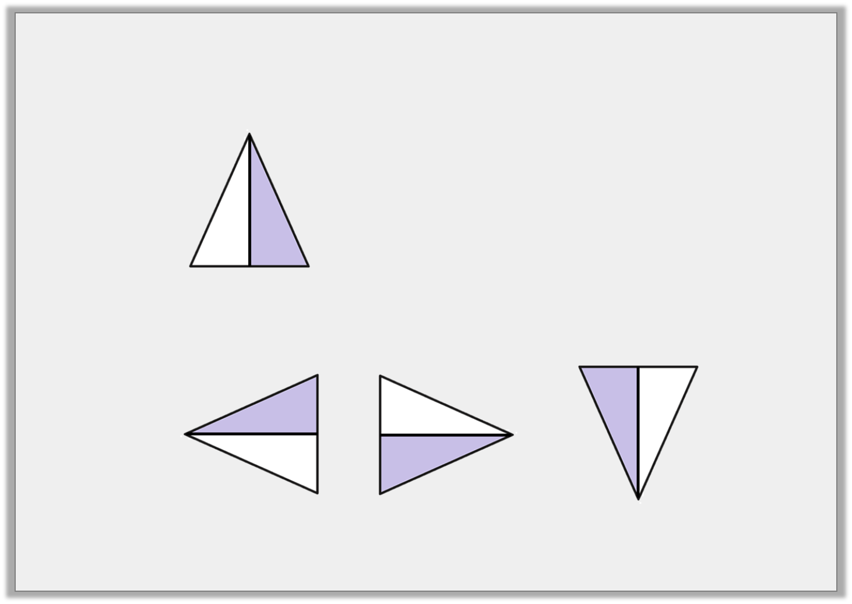
Varied Fluency 1
Identify the shape that has turned one right angle anti-clockwise.
Start:
Finish:
Y3
© Classroom Secrets Limited 2019

Slide 5
Varied Fluency 2
Identify any shapes that contain right angles.
Y3
© Classroom Secrets Limited 2019

Slide 6
Varied Fluency 3
How many right angles are in each shape?
Y3
© Classroom Secrets Limited 2019

Slide 7
Varied Fluency 4
This shape has 2 right angles. True or false?
Y3
© Classroom Secrets Limited 2019

Slide 8
Varied Fluency 1
Identify all the obtuse angles.
Y4
© Classroom Secrets Limited 2018

Slide 9
Varied Fluency 2
Use the symbols < or > to make the statements correct.
obtuse angle
90°
Y4
© Classroom Secrets Limited 2018

Slide 10
Varied Fluency 3
Identify the angle size to the correct label.
acute angle
obtuse angle
Y4
© Classroom Secrets Limited 2018

Slide 11

Problem Solving 1
Match the statements to the correct shape.
My shape has half the number of right angles as Sam’s shape.
Courtney
My shape has enough right angles to complete 1 full turn.
Sam
Sam’s shape has four more right angles than mine.
Lila
Y3
© Classroom Secrets Limited 2019

Slide 12
Problem Solving 2
Sort the shapes into the Carroll Diagram.
 | Has fewer than 3 right angles | Has 3 or more right angles
Has at least 4 sides
Does not have 4 sides
Y3
© Classroom Secrets Limited 2019

Slide 13
Reasoning 1
Which shape is the odd one out?
Explain why.
A
B
C
D
Y3
© Classroom Secrets Limited 2019

Slide 14
Reasoning 1
Which angle is the odd one out?
Explain your answer.
Y4
© Classroom Secrets Limited 2018

Slide 15
Problem Solving 2
Using the digits below, can you create
more obtuse or acute angles?
6
1
0
8
Y4
© Classroom Secrets Limited 2018

