Slide 1

Using formal written methods
Column subtraction

Slide 2
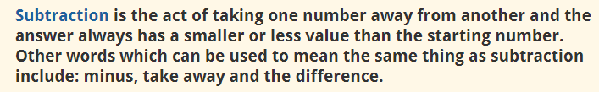

Slide 3
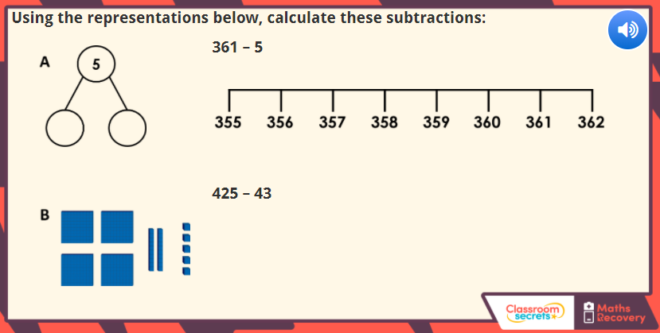

Slide 4
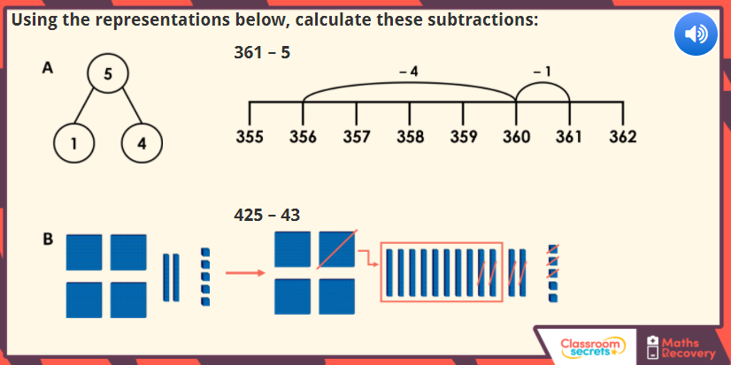

Slide 5
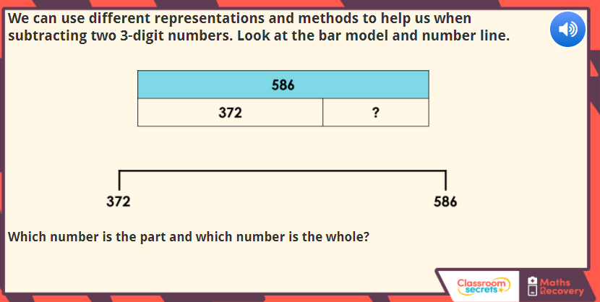

Slide 6
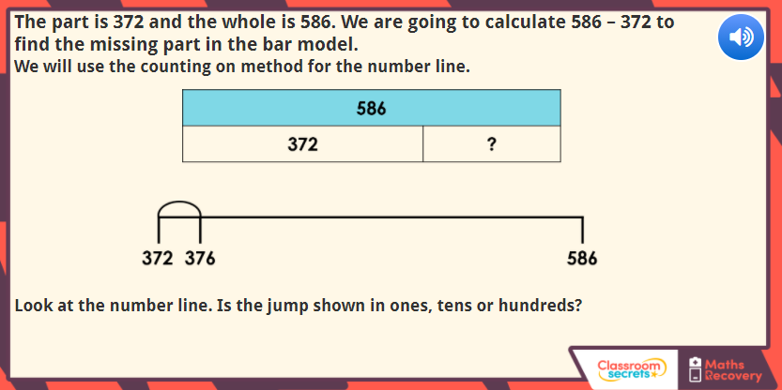

Slide 7
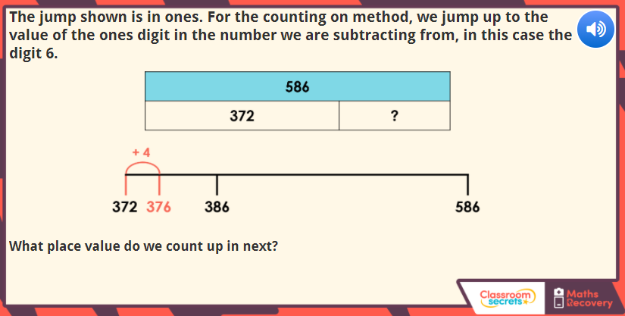

Slide 8
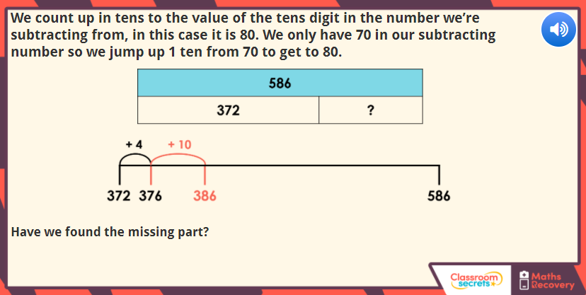

Slide 9
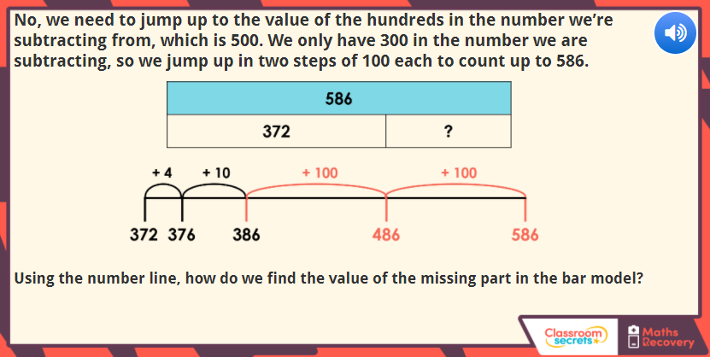

Slide 10
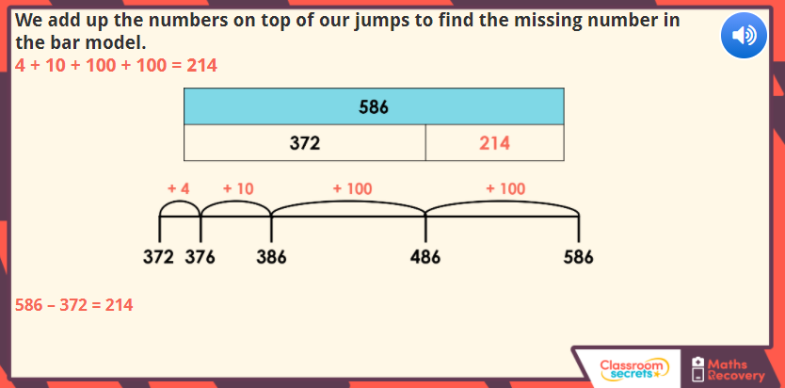

Slide 11
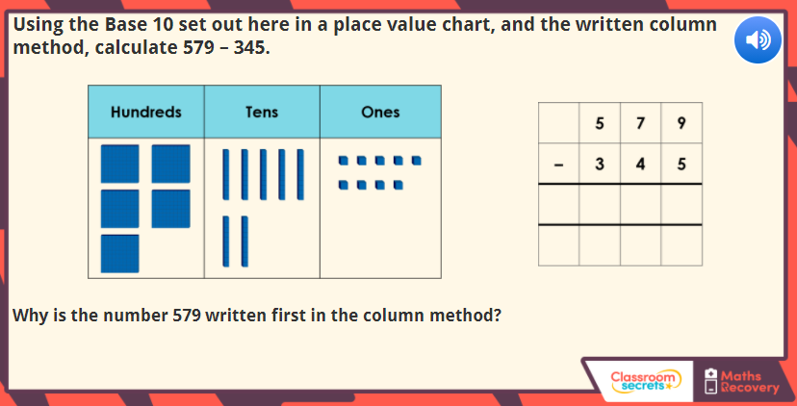

Slide 12
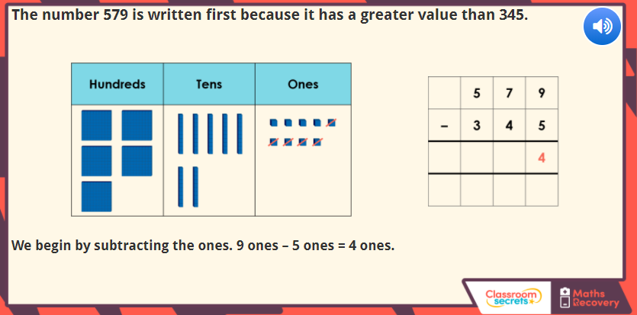

Slide 13
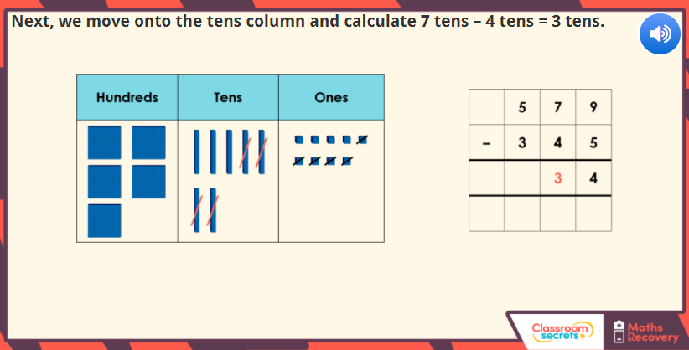

Slide 14
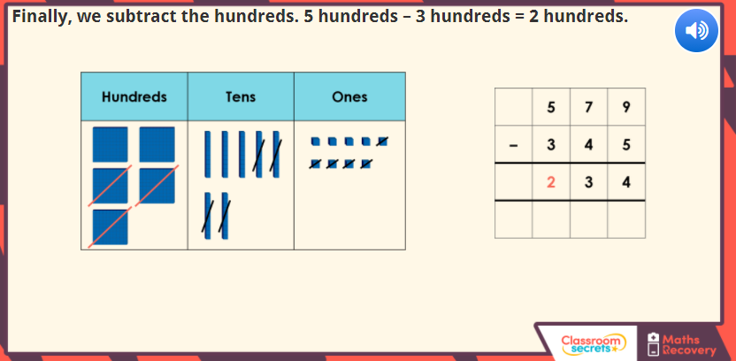

Slide 15
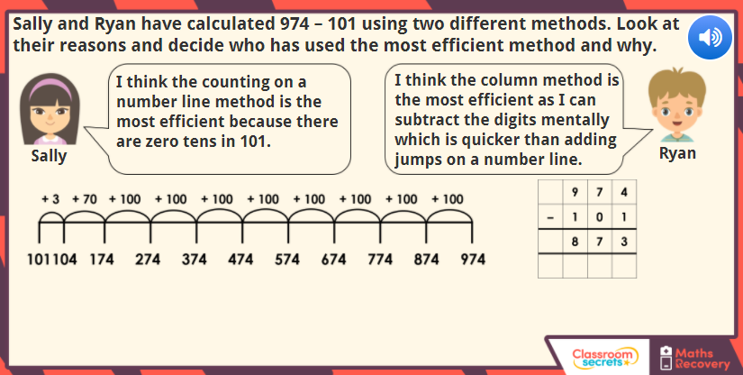

Slide 16
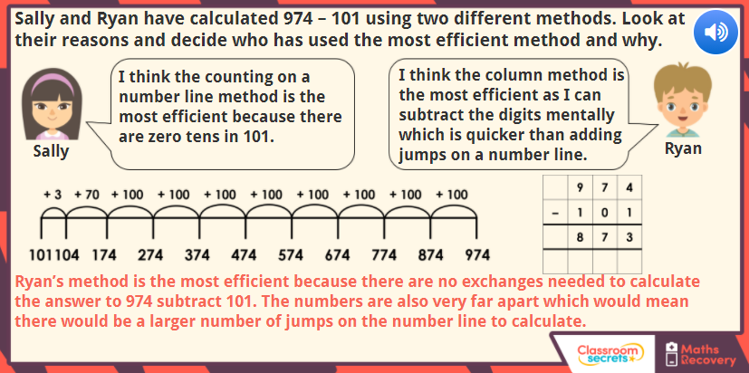

Slide 17
Use your knowledge of column subtraction to solve the following.
H T U
- 4 7 4
1 5 2
Use the key rules.
The digits must be lined up in a column. This has been done for you.
Subtract the column on the right first – this is often the units column, unless decimals are used like in money. So in this example, it is 4 – 2.
3. Then do the same with the column directly to the left of the one on the right. In this example, the tens column so 7 – 5.
You’ve guessed it, now subtract the H column. 4 - 1
Record your answer underneath each column in the large equals sign.
Look at your answer. Does it look correct? You could try estimating your answer first or checking your answer with the inverse operation.
Now complete your activity sheet following the same rules.

