Slide 1


Year 3 – Autumn Block 2 – Addition and Subtraction
Step 13: Add Two 3-Digit Numbers
© Classroom Secrets Limited 2018

Slide 2
Introduction
Match each group of counters with their equivalent value.
1
1
1
1
1
1,000
1
1
1
1
1
10
10
10
10
10
10
10
10
10
10
10
100
100
100
100
100
100
100
100
100
100
100
© Classroom Secrets Limited 2018

Slide 3
Introduction
Match each group of counters with their equivalent value.
1
1
1
1
1
1,000
1
1
1
1
1
10
10
10
10
10
10
10
10
10
10
10
100
100
100
100
100
100
100
100
100
100
100
© Classroom Secrets Limited 2018

Slide 4
Varied Fluency 1
234 add 453
 | H | T | O
+ |  |  | 
 |  |  | 
© Classroom Secrets Limited 2018

Slide 5
Varied Fluency 1
234 add 453
 | H | T | O
+ |  |  | 
 |  |  | 
 | 6 | 8 | 7
© Classroom Secrets Limited 2018

Slide 6
Varied Fluency 2
Fill in the box using <, > or =
 | H | T | O
+ |  |  |  
 |  |   | 
H | T | O
8 | 5 | 9
© Classroom Secrets Limited 2018

Slide 7
Varied Fluency 2
Fill in the box using <, > or =
 | H | T | O
+ |  |  |  
 |  |   | 
 | 8 | 6 | 9
H | T | O
8 | 5 | 9
>
© Classroom Secrets Limited 2018

Slide 8
Varied Fluency 3
Fill in the missing representations.
 | H | T | O
+ |  |  |  
 |  |  | 
 |  |  
 | 2 |  |  |  |  |  | 4
+ |  |  |  | 3 |  |  | 5
 | 6 |  |  | 6
© Classroom Secrets Limited 2018

Slide 9
Varied Fluency 3
Fill in the missing representations.
 | H | T | O
+ |  |  |  
 |   |  | 
 |   |   |   
 | 2 |  |  |  |  |  | 4
+ |  |  |  | 3 |  |  | 5
 | 6 |  |  | 6
3
4
9
© Classroom Secrets Limited 2018

Slide 10
Varied Fluency 4
Adam says that all these give the same answer. Do you agree?
A. | B.
 | H | T | O
+ |  |  |  
 |  |  |  
+ | 5 hundreds | 1 ten | 7 ones
 | 1 hundred | 4 tens | 2 ones
C.
 | 4 | 2 | 6
+ | 2 | 3 | 2
© Classroom Secrets Limited 2018

Slide 11
Varied Fluency 4
Adam says that all these give the same answer. Do you agree?
Adam is incorrect.
A and C = 658; B = 659
A. | B.
 | H | T | O
+ |  |  |  
 |  |  |  
 | 6 | 5 | 8
+ | 5 hundreds | 1 ten | 7 ones
 | 1 hundred | 4 tens | 2 ones
 | 6 | 5 | 9
C.
 | 4 | 2 | 6
+ | 2 | 3 | 2
 | 6 | 5 | 8
© Classroom Secrets Limited 2018

Slide 12
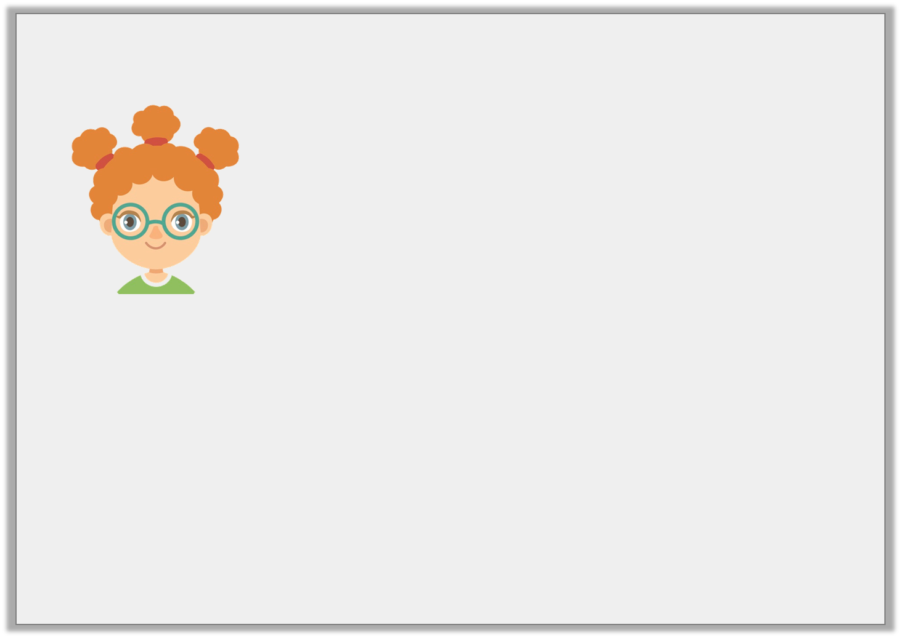
Reasoning 1
Natasha says,
Is Natasha correct? Prove it.
I can make a total of 867 if I add 3 hundreds, 2 tens and 4 ones to one of the numbers below.
A. | B. | C.
 | H | T | O
+
 |   |   |  
 | 8 | 6 | 7
 | H | T | O
+
 |   |   |  
 | 8 | 6 | 7
 | H | T | O
+
 |   |   |  
 | 8 | 6 | 7
© Classroom Secrets Limited 2018

Slide 13
Reasoning 1
Natasha says,
Is Natasha correct? Prove it.
Natasha is correct because…
I can make a total of 867 if I add 3 hundreds, 2 tens and 4 ones to one of the numbers below.
A. | B. | C.
 | H | T | O
+
 |   |   |  
 | 8 | 6 | 7
 | H | T | O
+
 |   |   |  
 | 8 | 6 | 7
 | H | T | O
+
 |   |   |  
 | 8 | 6 | 7
© Classroom Secrets Limited 2018

Slide 14
Reasoning 1
Natasha says,
Is Natasha correct? Prove it.
Natasha is correct because C: 324 + 543 = 867
I can make a total of 867 if I add 3 hundreds, 2 tens and 4 ones to one of the numbers below.
A. | B. | C.
 | H | T | O
+
 |   |   |  
 | 8 | 6 | 7
 | H | T | O
+
 |   |   |  
 | 8 | 6 | 7
 | H | T | O
+
 |   |   |  
 | 8 | 6 | 7
© Classroom Secrets Limited 2018

Slide 15
Problem Solving 1
Leaving no spaces, place 7 counters on each place value chart to create two 3-digit numbers. Add the numbers together to find the total.
Can you find three different possibilities?
H | T | O
H | T | O
+
© Classroom Secrets Limited 2018

Slide 16
Problem Solving 1
Leaving no spaces, place 7 counters on each place value chart to create two 3-digit numbers. Add the numbers together to find the total.
Can you find three different possibilities?
Various answers, for example: 521 + 322 = 833; 412 + 232 = 644; 151 + 331 = 482
H | T | O
H | T | O
+
© Classroom Secrets Limited 2018

Slide 17
Problem Solving 2
Jacob has a number shown below:
Which number can be added to Jacob’s to give a total greater than 570 and less than 580?
H | T | O
 |  | 
A. | B. | C.
 | H | T | O
+
 | 2 | 1 | 5
 | H | T | O
+
 |  |  | 
2 hundreds, 3 tens and 5 ones
© Classroom Secrets Limited 2018

Slide 18
Problem Solving 2
Jacob has a number shown below:
Which number can be added to Jacob’s to give a total greater than 570 and less than 580?
H | T | O
 |  | 
A. | B. | C.
 | H | T | O
+ | 3 | 5 | 4
 | 2 | 1 | 5
 | 5 | 6 | 9
 | H | T | O
+ | 3 | 5 | 4
 |  |  | 
 | 5 | 7 | 9
354 + 235 = 589
© Classroom Secrets Limited 2018

